Slide 1
Biyopotansiyel Elektrotlar
Yalova Üniversitesi
22 Kasım 2013

Slide 2
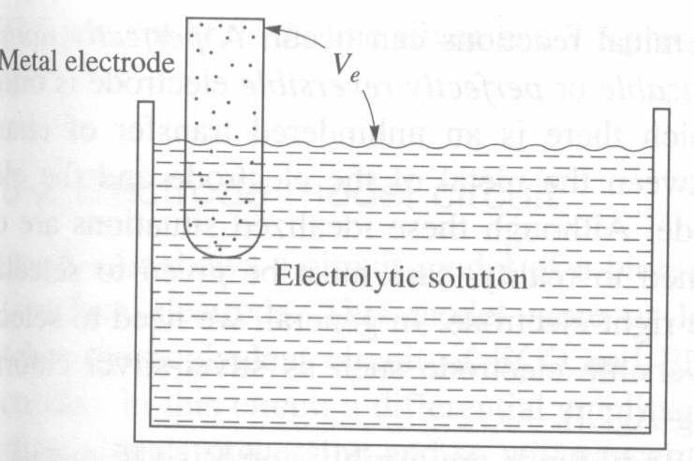
Yarım-hücre gerilimi
Üç ayrı tip madde üç şekilde birbiriyle temas haline getirilebilir
Katı–katı; ısıl çift (thermocouple)
Katı-sıvı; elektrot
Sııvı-sıvı; iyon seçici bir membranla ayrılmış, hücre gerilimlerinde olduğu gibi
Yarım-hücre gerilimi = E_{hc} = V_{e}
Elekrot-elektrolit arayüzeyinde oluşan iyon dengesizliklerinden dolayı
Notes:
Carr 6-11

Slide 3
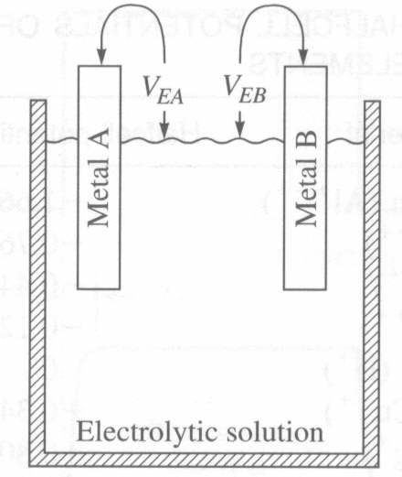
Ortak bir elektrolitik çözeltideki farklı iki metal
Elektrotlar arasındaki net gerilim
= V_{EA} – V_{EB}
Notes:
Carr 6-12

Slide 4
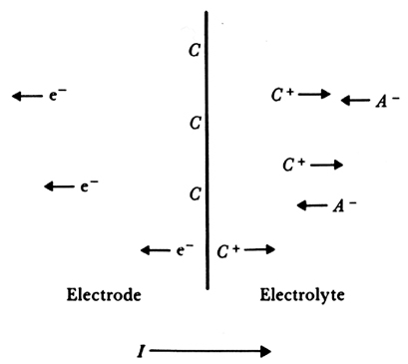
Elektrot-elektrolit arayüzü
Notes:
W5-1

Slide 5
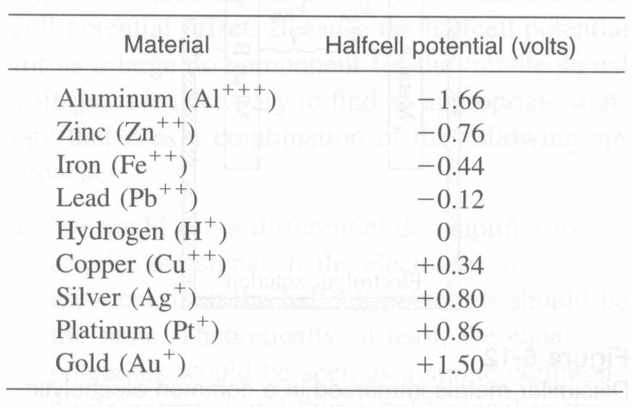
Yaygın kullanılan elemanların yarım-hücre gerilimleri

Slide 6
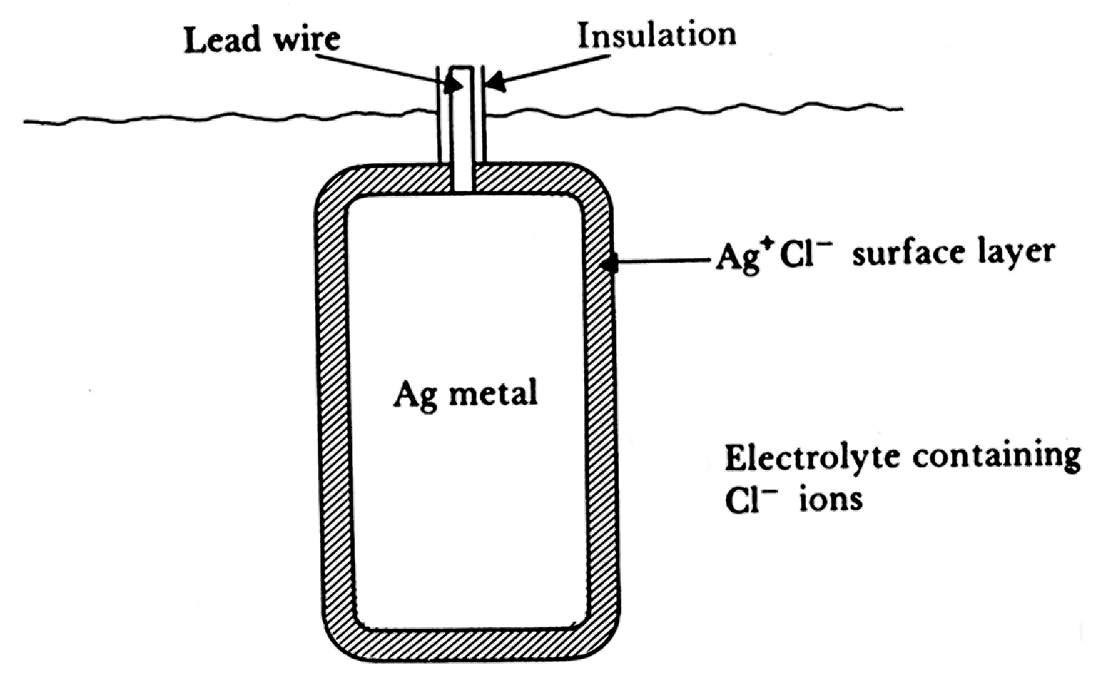
Bir gümüş-gümüş klorür elektrotunun kesiti

Slide 7
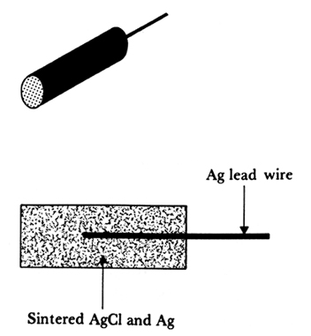
Sinterlenmiş Ag/AgCl elektrot

Slide 8
Polarizasyon
Overpotential = observed half-cell potential – equilibrium zero current half-cell potential
V_{p} = V_{r} + V_{c} + V_{a}
V_{p} = total overpotential or polarization potential
V_{r} = ohmic overpotential
V_{c} = concentration overpotential
V_{a} = activation overpotential

Slide 9
Polarize olan ve olmayan elektrotlar
Perfectly polarizable
  No actual charge crosses electrode-electrolyte interface when current is applied
  The current is the displacement current as in a capacitor
Perfectly nonpolarizable
  Current passes through electrode-electrolyte interface freely without requiring additional energy
  No overpotentials
Neither is practically possible
  Electrodes made up noble metals such as platinum behave closest to perfectly polarizable
  silver-silver chloride electrodes behaves closest to perfectly nonpolarizable

Slide 10
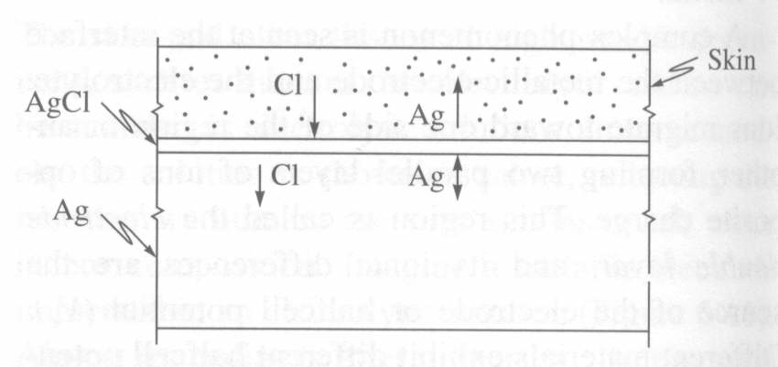
Gümüş-gümüş klorür elektrotların davranışı
Notes:
Carr 6-13

Slide 11
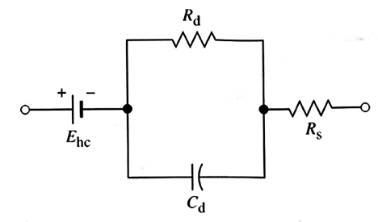
Elektrolitle temas halindeki bir biyopotensiyel elektrotun eşdeğer devresi
Notes:
W5-4

Slide 12
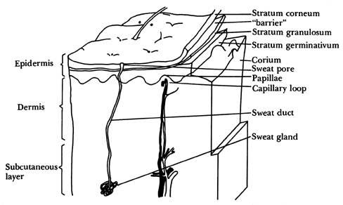
Elektrot-deri arayüzü ve hareket hataları
Derinin çeşitli kademelerinin büyütülmüş bir görüntüsü
Notes:
W5-7

Slide 13
Deri arayüzlü bir model
E_{he}
Electrode
C_{d}
R_{d}
Sweat glands
Gel
R_{s}
and ducts
E_{se}
E_{P}
Epidermis
C_{e}
R_{e}
C_{P}
R_{P}
Dermis and
subcutaneous layer
R_{u}
Notes:
W5-8

Slide 14
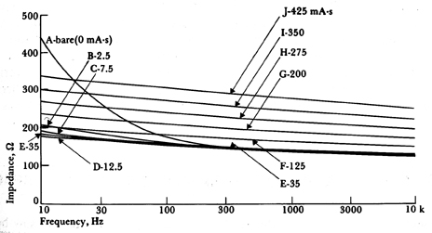
Ag/AgCl elektrotların empedansının frekansla değişimi

Slide 15
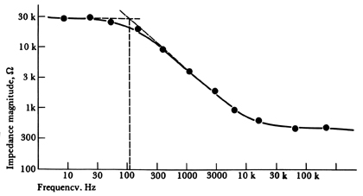
Elektrot empedansının frekansla değişiminin deneysel sonucu

Slide 16
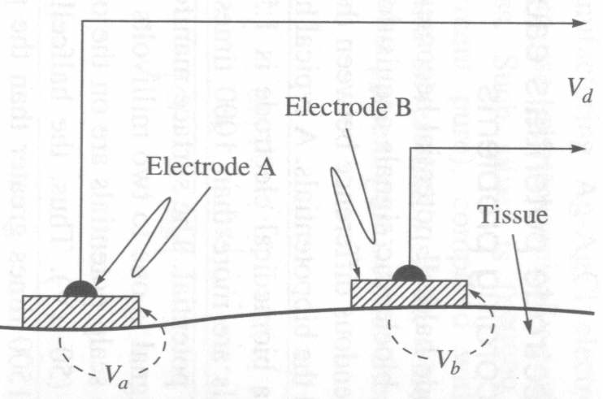
Biyopotensiyel kaydı için deri üzerine yerleştirilen iki biyopotansiyel elektrot
Notes:
Carr 6-14a

Slide 17
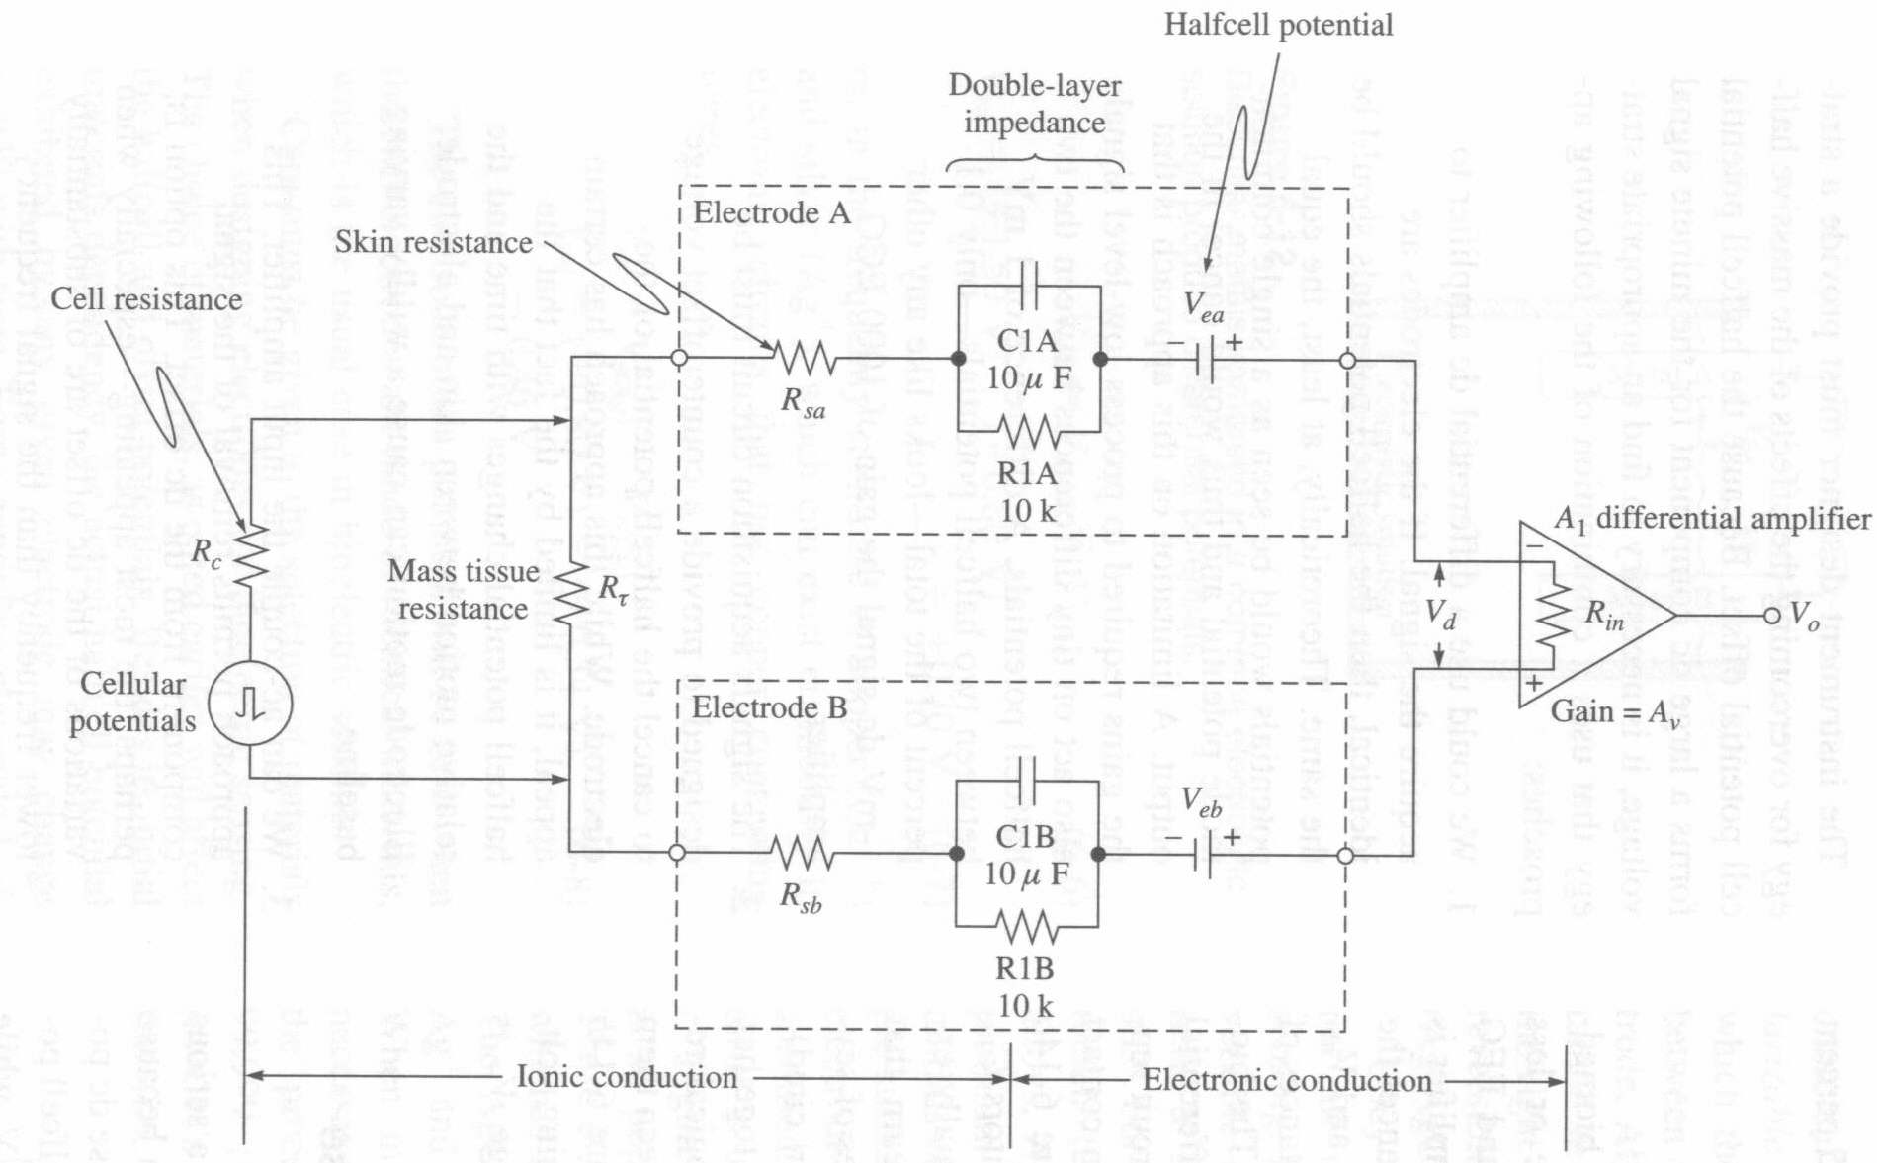
Bir biyomedikal kayıtın devre modeli

Slide 18
Elektrot tipleri
Vücut yüzeyinden kayıt için elektrotlar
  Metal-plaka
  Emme (Suction)
  Yüzer (gömme – sütun) (Floating (recessed -column))
  Esnek (elastiki)
İç (internal) elektrotlar
  İğne Needle
  Tel
  Yerleştirilmiş (indwelling)
Elektrot dizileri
Mikro elektrotlar
  Metal
  Destekli metal
  mikropipet

Slide 19
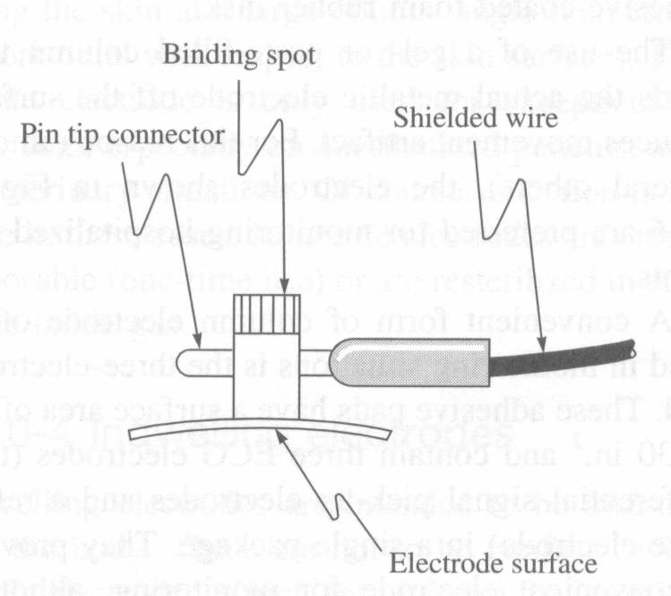
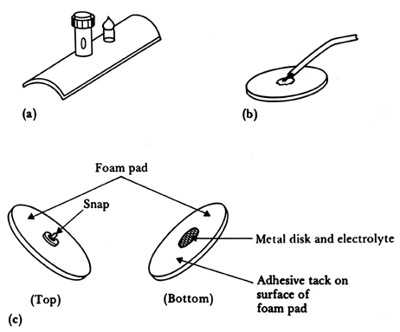
Biyopotansiyel vücut yüzeyi elektrotları
Metal plaka
Metal disk
EKG kayıtlrında sık kullanılan köpük arkalıklı tek kullanımlık elektrode
Notes:
W5-9, Carr 6-15a

Slide 20
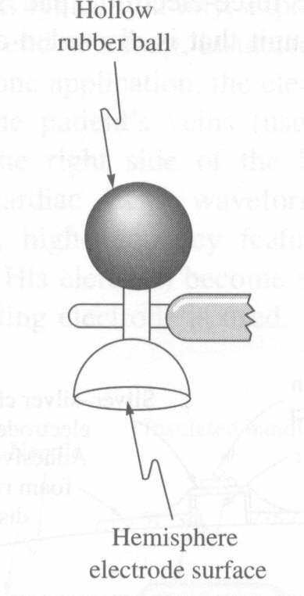
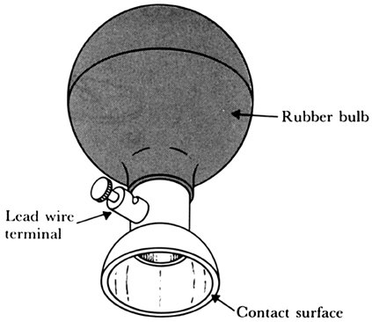
Metalik emme elektrot
Genellilkle klinik elektrokardiograf uygulamalarında gögüs üzerine yerleştirilen bir metalik emme elektrodu
Notes:
W5-10, Carr 6-

Slide 21
Yüzer (gömme – sütun) elektrot
Metal disk
Insulating
package
Double-sided
Adhesive-tape
ring
Recessed electrode with top-hat structure
Electrolyte gel
in recess
(a)
(b)
Snap coated with Ag-AgCl
External snap
Gel-coated sponge
Plastic cup
Plastic disk
Disposable recessed electrode
Foam pad
Tack
Dead cellular material
Capillary loops
Germinating layer
(c)
Notes:
W5-11

Slide 22
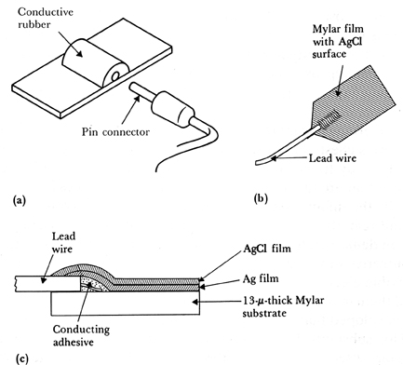
Esnek yüzey elektrotları
Carbon-filled silicon rubber electrode
Flexible thin-film neonatal electrode
Cross-sectional view of thin-film electrode
Notes:
W5-12

Slide 23
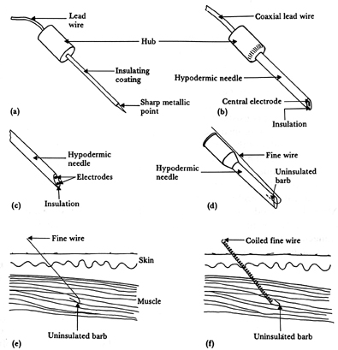
Figure 5.13 Needle and wire electrodes for percutaneous measurement of biopotentials (a) Insulated needle electrode. (b) Coaxial needle electrode. (c) Bipolar coaxial electrode. (d) Fine-wire electrode connected to hypodermic needle, before being inserted. (e) Cross-sectional view of skin and muscle, showing coiled fine-wire electrode in place.

Slide 24
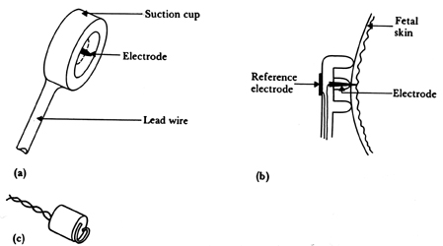
FECG Electrodes
Figure 5.14 Electrodes for detecting fetal electrocardiogram during labor, by means of intracutaneous needles (a) Suction electrode. (b) Cross-sectional view of suction electrode in place, showing penetration of probe through epidermis. (c) Helical electrode, which is attached to fetal skin by corkscrew type action.

Slide 25
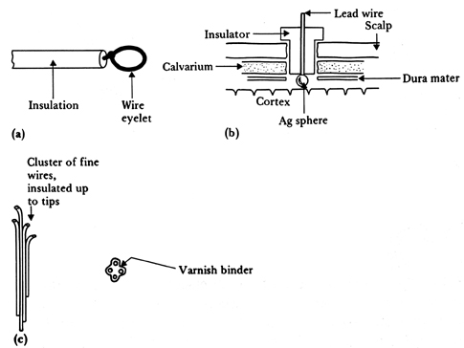
Implantable Electrodes
Figure 5.15 Implantable electrodes for detecting biopotentials (a) Wire-loop electrode. (b) Silver-sphere cortical-surface potential electrode. (c) Multielement depth electrode.

Slide 26
Microarray electordes
Insulated leads
Contacts
Ag/AgCl electrodes
Contacts
Ag/AgCl electrodes
Base
(b)
Insulated leads
Base
Exposed tip
Tines
(a)
Figure 5.16 Examples of microfabricated electrode arrays. (a) One-dimensional plunge electrode array (after Mastrototaro et al., 1992), (b) Two-dimensional array, and (c) Three-dimensional array (after Campbell et al., 1991).
Base
(c)

Slide 27
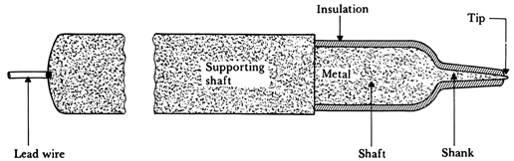
Metal Microelectrodes
Figure 5.17 The structure of a metal microelectrode for intracellular recordings.

Slide 28
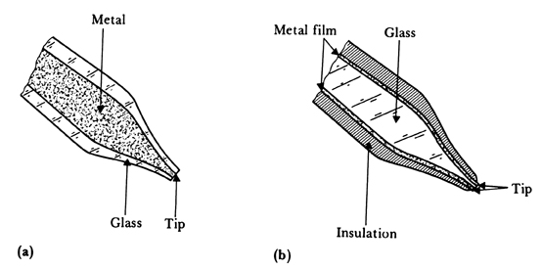
Microelectrodes
Figure 5.18 Structures of two supported metal microelectrodes (a) Metal-filled glass micropipet. (b) Glass micropipet or probe, coated with metal film.

Slide 29
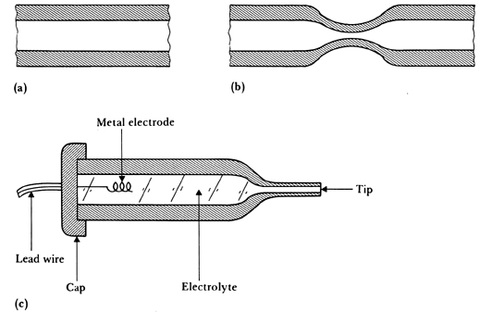
Glass Micropipet Electrodes
Figure 5.19 A glass micropipet electrode filled with an electrolytic solution (a) Section of fine-bore glass capillary. (b) Capillary narrowed through heating and stretching. (c) Final structure of glass-pipet microelectrode.

Slide 30
Yarı-iletken Mikro-elektrodes
Bonding pads
Insulated
lead vias
SiO₂ insulated
Au probes
Exposed
electrodes
Silicon probe
Si substrate
Exposed tips
(a)
(b)
Miniature
insulating
chamber
Hole
Channels
Silicon chip
Lead via
Silicon probe
Contact
metal film
(c)
Electrode
(d)
Figure 5.20 Different types of microelectrodes fabricated using microelectronic technology (a) Beam-lead multiple electrode. (Based on Figure 7 in K. D. Wise, J.B. Angell, and A. Starr, "An Integrated Circuit Approach to Extracellular Microelectrodes." Reprinted with permission from IEEE Trans. Biomed. Eng., 1970, BME-17, pp. 238-246. Copyright (C) 1970 by the institute of Electrical and Electronics Engineers.) (b) Multielectrode silicon probe after Drake et al. (c) Multiple-chamber electrode after Prohaska et al. (d) Peripheral-nerve electrode based on the design of Edell.

Slide 31
Eşdeğer devre
N = Nucleus
C = Cytoplasm
A
R_{s}
A
Insulation
Metal rod
C_{w}
B
C_{d2}
B
Cell
membrane
C_{d}
Tissue fluid
+
+
Reference
electrode
R_{ma}
C_{ma}
C_{mb}
R_{mb}
+
−
−
−
+
Membrane
potential
C_{di}
+
+
−
C
−
+
E_{ma}
E_{mb}
+
−
−
−
+
−
N
−
+
R_{i}
E_{mp}
R_{e}
+
−
−
+
+
−
−
−
−
−
−
−
−
+
(b)
+
+
+
+
+
−
−
+
+
+
(a)
R_{ma}
Figure 5.21 Equivalent circuit of metal microelectrode (a) Electrode with tip placed within a cell, showing origin of distributed capacitance. (b) Equivalent circuit for the situation in (a). (c) Simplified equivalent circuit. (From L. A. Geddes, Electrodes and the Measurement of Bioelectric Events, Wiley-Interscience, 1972. Used with permission of John Wiley and Sons, New York.)
E_{mp}
Membrane
and
action
potential
A
C_{ma}
0
C_{d} + C_{w}
E
E_{ma} - E_{mb}
B
(c)

Slide 32
Eşdeğer devre
A
To amplifier
B
A
B
Electrolyte
in
micropipet
Glass
R_{ma}
C_{ma}
Internal electrode
Stem
E_{ma}
Environmental
fluid
R_{t}
C_{d}
C_{mb}
R_{mb}
Taper
C_{d}
E_{j}
Cell
membrane
Tip
Reference
electrode
E_{mb}
+
+
+
+
+
E_{t}
+
−
−
−
−
−
+
+
−
−
−
−
+
+
−
N
−
+
(b)
R_{i}
R_{e}
+
−
Cytoplasm
N = Nucleus
−
−
+
+
E_{mp}
+
−
−
−
−
−
(a)
+
+
−
−
+
+
+
+
Cell membrane
R_{t}
Figure 5.22 Equivalent circuit of glass micropipet microelectrode (a) Electrode with its tip placed within a cell, showing the origin of distributed capacitance. (b) Equivalent circuit for the situation in (a). (c) Simplified equivalent circuit. (From L. A. Geddes, Electrodes and the Measurement of Bioelectric Events, Wiley-Interscience, 1972. Used with permission of John Wiley and Sons, New York.)
A
Membrane
and
action
potential
0
C_{d} = C_{t}
E_{mp}
E_{m}
(c)
E_{m} = E_{j} + E_{t} + E_{ma}- E_{mb}
B

Slide 33
Gerilim ve Akım Uyarıları
i
Figure 5.23 Current and voltage waveforms seen with electrodes used for electric stimulation (a) Constant-current stimulation. (b) Constant-voltage stimulation.
t
υ
Polarization
potential
Ohmic
potential
Polarization
potential
t
(a)
υ
t
i
Polarization
Polarization
t
(b)

