Slide 1
İŞLEMSEL KUVVETLENDİRİCİLER (OP-AMPS) VE İŞARET İŞLEME UYGULAMALARI
Temel ilkeler, Süzgeçler, Entegratörler, Türev alıcılar ve Enstrümentasyon (Cihaz) Kuvvetlendiricileri

Slide 2
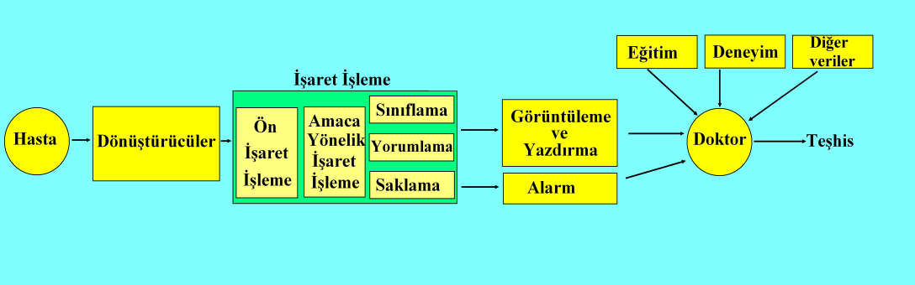
Genel Ölçme ve Tanımlama Sistemi

Slide 3
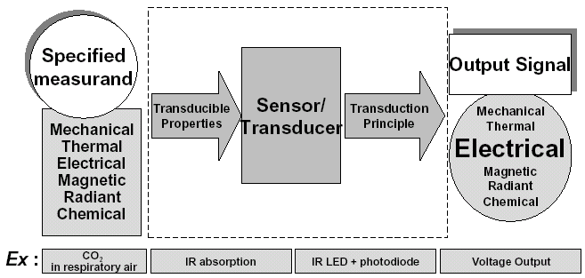
Algılayıcılar (Sensors ): tanım ve ilkeleri

Slide 4
İşaret İşleyici Örnekleri
Temel kuvvetlediriciler
Enstrümentasyon kuvvetlendiricileri – geliştirilmiş bir farksal kuvvetlendirici
Aktif süzgeçler
Entegratör (toplama) ve türev alma
Önemli ekler:
  Hassas doğrultucular
  Logaritmik kuvvetlendiriciler
  Negatif kapasitans kuvvetlendiricileri

Slide 5
İşaret Koşullandırma
Ideal işlemsel kuvetlendirici (operational amplifier – op-amp)
Eviren, evirmeyen ve enstrümentasyon (cihaz) kuvvetlendiricisi
Entegratör (toplama), türev (differensiyel)
Süzgeçler (Filters)
İşaret koşullandırma modül örneklari
Notes:
This slide shows the topics of signal conditioning.

Slide 6
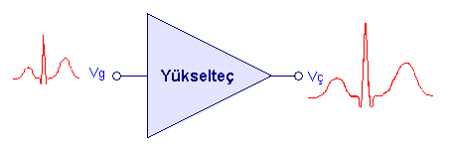
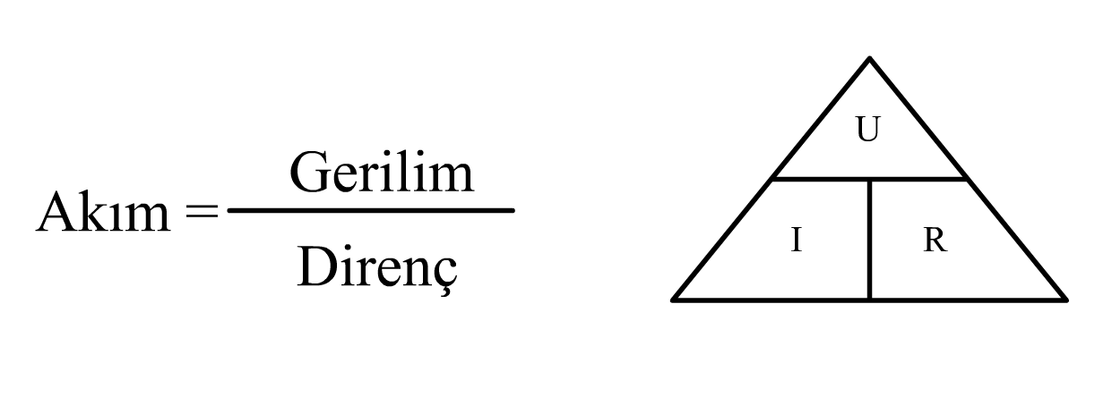
Kuvvetlendirici (Yükselteç – Amplifikatör)
Kazanç K veya G (Gain) = Çıkış Değeri / Giriş Değeri

Slide 7
Kuvvetlendirici Tipleri
Gerilim kontrollü gerilim kuvvetlendiricisi (basit op-amp)
Gerilim kontrollü akım kuvvetlendiricisi (operational transconductance amplifier – OTA
Akım kontrollü gerilim kuvvetlendiricisi (transimpedance)
Akım kontrollü akım kuvvetlendiricisi

Slide 8
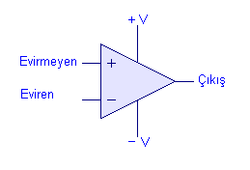
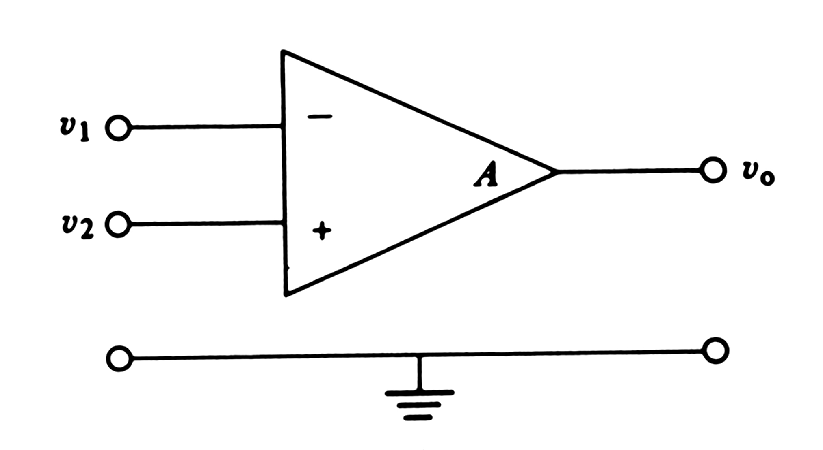
İdeal Bir İşlemsel Kuvvetlendirici
Notes:
Operational (OP) amplifier is a high-gain dc differential amplifier. It is normally used in circuits that have characteristics determined by external negative feedback networks. Ideal OP amplifier is the best model for the design and analysis of amplifier circuits. It has two inputs, negative terminal v1 and positive terminal v2 and one output v0. The effective input to the amplifier is the voltage difference of the two inputs v1-v2. This is why the amplifier is called differential amplifier.

Slide 9
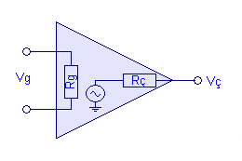
İdeal op-amp İçin Temel Kurallar
Özellikleri
  Sonsuz kazanç (A=∞)
  v₁ = v₂ ise V₀ = 0
  Giriş empedansı sonsuz
  Çıkış empedansı sıfır
  Bant genişliği sonsuz ve faz kayması yok.
Temel Kurallar
  Op-amp’in çıkışı lineer bölgede ise, her iki girişteki gerilim aynıdır (birbirine eşittir)
  Op-amp’in girişinden hiç akım akmaz.
Notes:
Ideal OP amplifier has many properties. The gain is assumed to be infinite. Real OP amplifiers has the gain greater than 10⁵ or 100dB. This gain can be considered as infinite. When the potential of both input terminals are equal, there is no voltage output (0 V). The input impedance is infinity, which means the amplifier use the little energy from the source. It is important because most sensors, the source for the amplifier input, has very limited energy output capacity. The real OP amplifier has the input impedance that can easily exceed 1GΩ. The zero output impedance means that the amplifier can maximize its output power. There is also no distortion to the signal because the bandwidth id infinitely wide and has no phase shift.
The two rules are important for the analysis of circuits made of OP amplifiers. It implies that the voltage of one terminal must follow the voltage of the other. Otherwise the output voltage would be infinity or out of the linear range because of the infinite gain of the amplifier. Since the input impedance is infinite, the current flowing through the input terminal will be zero. In real amplifier, the current is less than 1µA.

Slide 10
Devre Elemanı Olarak Op-amp

Slide 11
Eviren Kuvvetlendirici
I = V_{i} / R₁
Sanal (Virtual)
toprak
R_{f}
R₁
I
V_{i}
-
V₀
A
Gerçek
toprak
+
V₀ = - ( R_{f} / R₁ ) * V_{i}

Slide 12
Devre Bağlantısı

Slide 13
Giriş-Çıkış Özellikleri

Slide 14
Toplama Kuvvetlendiricisi
I₁ = V₁ / R₁
I₂ = V₂ / R₂
V₀ = - ( R_{f} / R₁ ) * V₁ - ( R_{f} / R₂ ) * V₂

Slide 15
Toplayıcı
R_{i}
R_{f}
+10
10 kΩ
100 kΩ
υ_{i}
υ_{i}
−
υ_{i} + υ_{b} /2
+15V
R_{b}
υ_{o}
0
20 kΩ
Voltage, V
Time
5 kΩ
+
v
b
-15 V
-10
υ_{o}
(a)
(b)
(a) This circuit sums the input voltage υ_{i} plus one-half of the balancing voltage υ_{b} . Thus the output voltage υ_{o} can be set to zero even when υ_{i} has a nonzero dc component. (b) The three waveforms show υ_{i} , the input voltage; (υ_{i} + υ_{b} /2), the balanced-out voltage; and υ_{o} , the amplified output voltage. If υ_{i} were directly amplified, the op amp would saturate.

Slide 16
Toplayıcı Kuvvetlendirici Uygulaması

Slide 17
Toplayıcı Kuvvetlendirici Örneği

Slide 18
Gerilim İzleyici - Tampon
R_{i} →∞

Slide 19
Evirmeyen Kuvvetlendirici
I_{f} = V_{i} / R₁
R_{i} →∞
V₀ = (1+ R_{f} / R₁ ) * V_{i}

Slide 20
Giriş-Çıkış Özellikleri

Slide 21
Evirmeyen Kuvvetlendirici (temel)

Slide 22
Evirmeyen Kuvvetlendirici Örneği

Slide 23
Gerilim Bölücülü Evirmeyen Kuvvetlendirici
V₂ = V₁ * R₄ / (R₃+R₄ )
V₀ = (1+ R₂ / R₁ ) * V₂
R_{i} = V₁ / I_{i} = R₃+R₄
V₀ = (R₄/(R₃+R₄))* (1+ R₂ / R₁ ) * V₁

Slide 24
Gerilim Bölücüye Örnek-1
Vo/Vi =

Slide 25
Örnek-2
Vo/Vi =

Slide 26
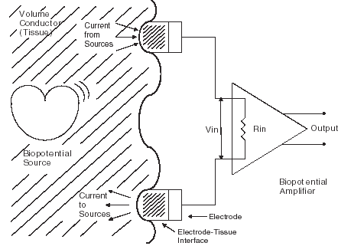
Biyopotensiyel İşaret Kaynağı

Slide 27
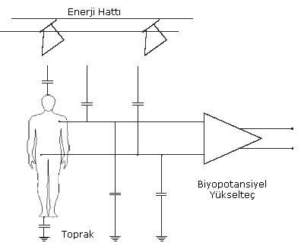
Gürültü Kaynakları

Slide 28
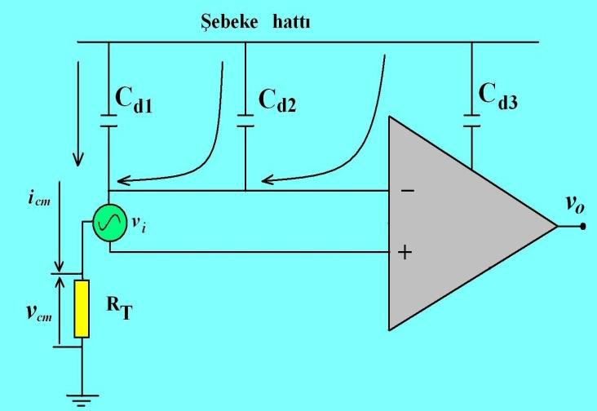
Şebeke Hattından Olan Kapasitif Kuplajların Etkileri

Slide 29
Temel Fark Kuvvetlendiricisi
V₅ = V₄ * R₄ / (R₃+R₄ )
I_{f} = (V₅ - V₃) / R₃ = (V₀ – V₅)/ R₄
G_{C} =2*V₀/(V₄ + V₃)
G_{d} =V₀/(V₄ - V₃) = R₄ / R₃
CMRR = G_{d}/G_{C}
V₀ = (V₄ - V₃)*R₄ / R₃ + G_{C}* (V₄ + V₃)/2

Slide 30
Giriş-Çıkış Özellikleri
G_{C} =V₀/V_{CM} =
Deneysel olarak bulunur
G_{d} =V₀/V_{d} = R₄ / R₃
CMRR = G_{d}/G_{C}
R_{i3} =V₃/I₃ = R₃
R_{i4} =V₄/I₄ = R₃ + R₄

Slide 31
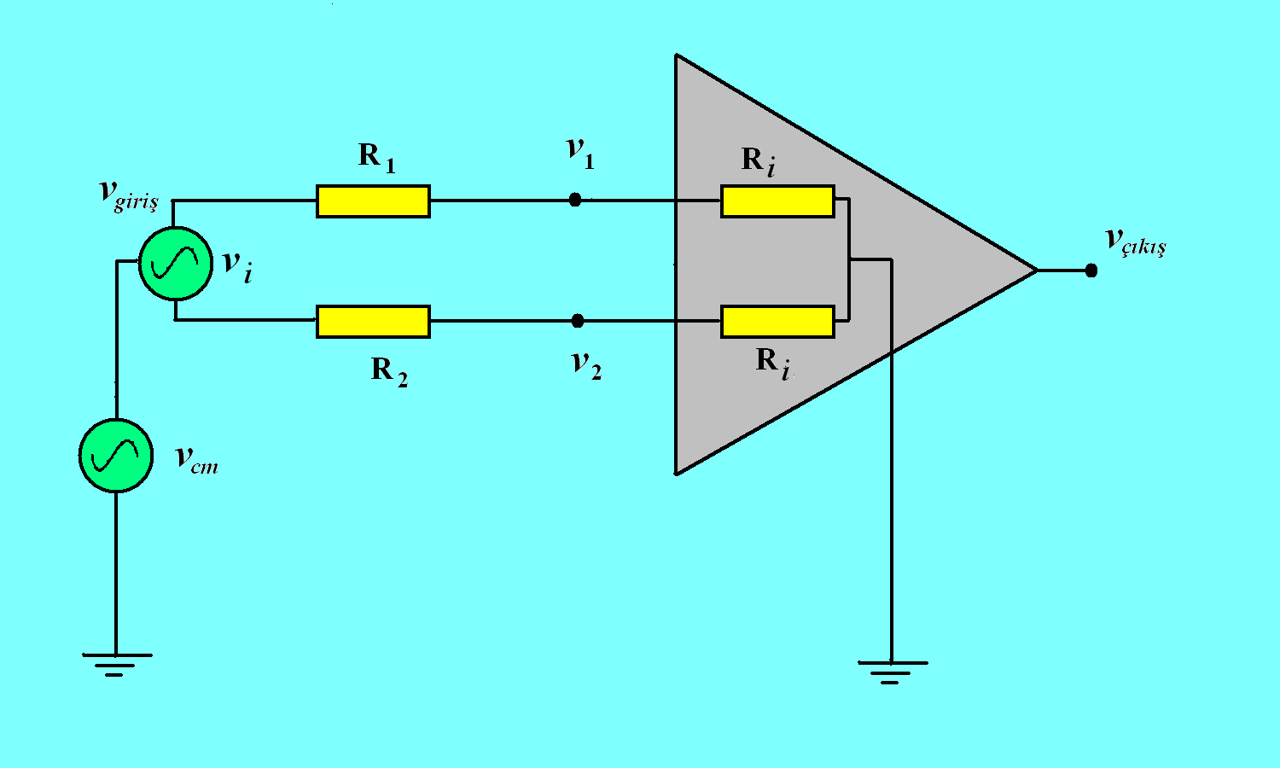
Kuvvetlendiricinin Giriş Dirençlerindeki Dengesizliğin Etkisi

Slide 32
Girişi Koşullandırma: Fark İşaret
i_{R1} = i_{R2a} = i_{R2b} olduğundan farksal (diferensiyel) çıkış gerilimi:
Farksal giriş gerilimi ise:
Böylece farksal kazanç:
R₂
i_{R2a}
V_{S+}
v_{a}
v_{a}'
i_{R1}
V_{S–}
R₁
R₂
i_{R2b}
V_{S+}
v_{b}'
v_{b}
V_{S–}

Slide 33
Girişi Koşullandırma: Ortak İşaret
Giriş koşullandırma ortak işareti kuvvetlendirmez!
Bunun da nedeni şöyledir:
  v_{b} – v_{a} = i_{R1}R₁ olduğundan
  Böylece çıkış gerilimi de:
R₂
i_{R2a}
V_{S+}
v_{a}
v_{a}'
i_{R1}
V_{S–}
R₁
R₂
i_{R2b}
V_{S+}
v_{b}'
v_{b}
V_{S–}

Slide 34
Enstrümentasyon Kuvvetlendiricisi
Toplam kazanç:
R₂
V_{S+}
R₄
v_{a}
V_{S+}
R₃
V_{S–}
v_{o}
R₁
R₂
R₃
V_{S–}
Input
Conditioner
V_{S+}
R₄
Difference
Amplifier
v_{b}
V_{S–}

Slide 35
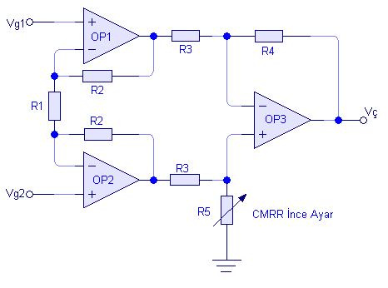
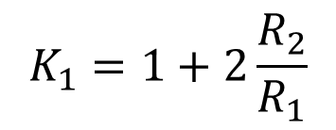
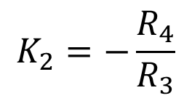
Yüksek Ortak Mod Tepkil Oranlı Enstrümentasyon Kuvvetlendirici
Devrenin kazancı
$$K_{1}=1+2\frac{R_{2}}{R_{1}}$$
$$K_{2}=−\frac{R_{4}}{R_{3}}$$
K = K1*K2

Slide 36
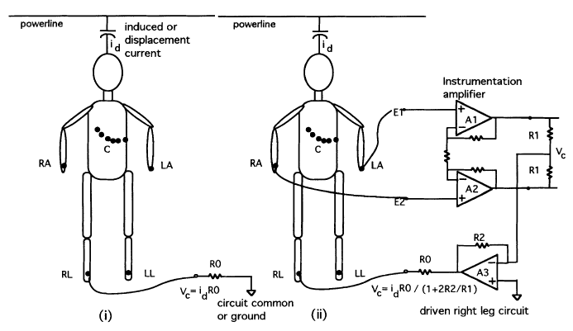
Fark İşaretleri ve Enstrümentasyon Kuvvetlendirici Uygulaması

Slide 37
Karşılaştırıcılar: Temel Kurallar
V₀=A(V₂-V₁)
V₀ = 0 şayet V₁ = V₂
V₀ = +V_{SAT} şayet V₁ < V₂
V₀ = -V_{SAT} şayet V₁ > V₂
Op-amp’in girişlerinden akım akmaz.

Slide 38
Basit Karşılaştırıcı (eviren)
V₋ = (V_{i}*R₂+V_{ref}*R₁)/(R₁+R₂)
V_{SAT}
Şayet V₋<0 ise çıkış +V_{SAT} kalır
Şayet V₋>0 olursa çıkış –V_{SAT} a gider
-V_{SAT}

Slide 39
Histerizli Karşılaştırıcı
V₋ = (V_{i}*R₂+V_{ref}*R₁)/(R₁+R₂)
V₊ = V₀*R₃ /(R₃+R₄)
V₋<V₊ çıkış +V_{SAT} da kalır
Şayet V₋>V₊ olursa çıkış –V_{SAT} a gider

Slide 40
Özellikler
V_{H} = -V_{ref}*R₁/R₂ – V_{SAT}*R₃/(R₃+R₄)
V_{L} = -V_{ref}*R₁/R₂ + V_{SAT}*R₃/(R₃+R₄)

Slide 41
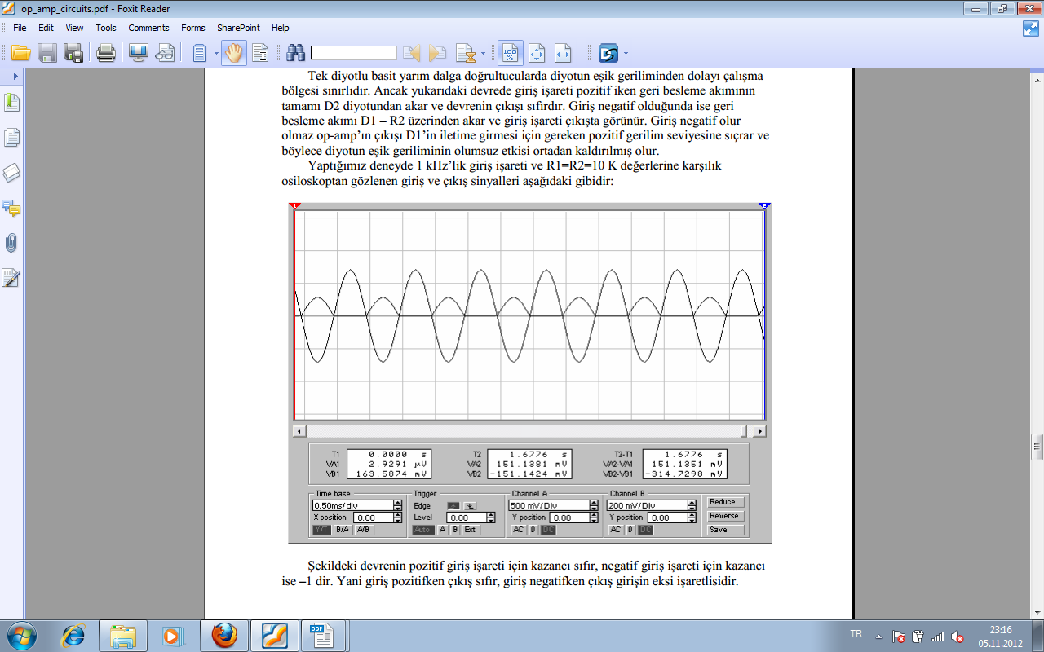
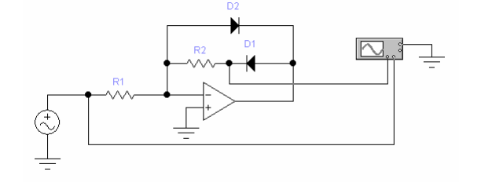
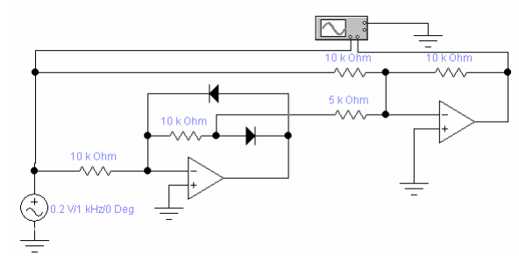
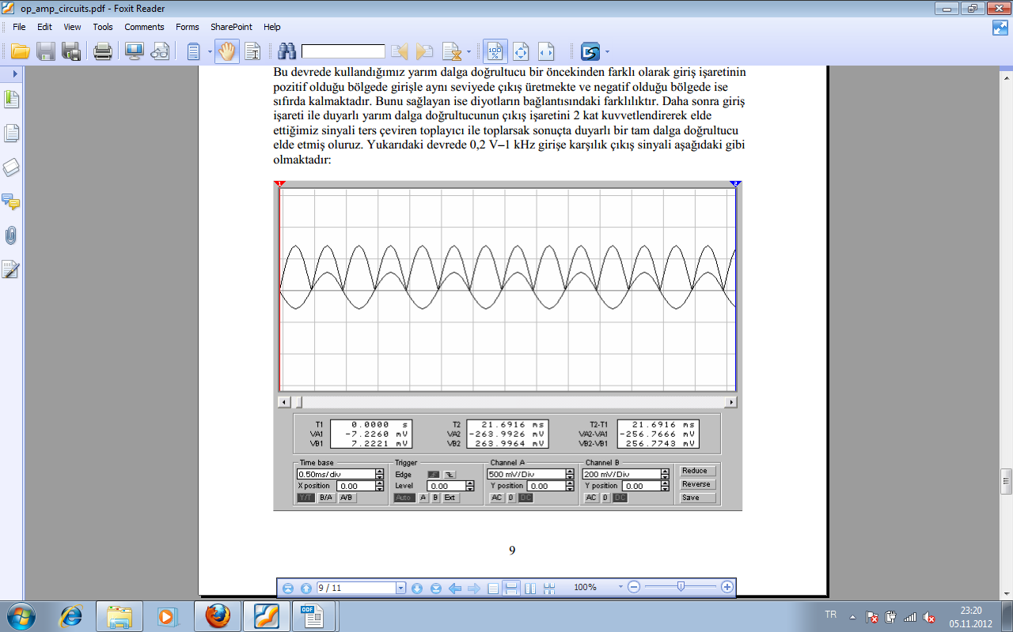
Hassas Doğrultucular
Hassas Yarım Dalga Doğrultucu Devresi
Hassas Yarım Dalga Doğrultucu Devresi
Hassas Tam Dalga Doğrultucu Devresi
Notes:
HASSAS DOĞRULTUCULAR
Yukarıda anlatılan yarım ve tam dalga doğrultucularda diyot kullanılmaktadır. Klasik diyotların doğrultmaç devrelerinde oluşturduğu bazı dezavantajlı durumlar vardır.doğrultucu devrelerin yarattığı sakıncaları önlemek ve daha hassas ölçüm yapmak için biyomedikal sistemlerde OPAMP'lı hassas doğrultucular kullanılır. Opampın giriş empedansı teorikte sonsuz olduğu İçin kaynak devreden fazla akım çekmez. Böylece giriş sinyalinin bozulmasını engeller.

Slide 42
Hassas Doğrultucular
R
(1-x)R
D₁
D₂
υ_{o}
υ_{i}
R_{i} = 2 kΩ
R_{f} = 1 kΩ
xR
10 V
v
o
−
−
D
-10 V
10 V
R_{L} = 3 kΩ
υ_{i}
+
+
R
υ_{i}
D₄
υ_{o}=
υ_{i}
(c)
D₃
x
-10 V
−
+
(b)
(a)
(a) Full-wave precision rectifier. For υ_{i} > 0, the noninverting amplifier at the top is active, making υ_{o} > 0. For υ_{i} < 0, the inverting amplifier at the bottom is active, making υ_{o} > 0. Circuit gain may be adjusted with a single pot. (b) Input-output characteristics show saturation when υ_{o} > +13 V. (c) One-op-amp full-wave rectifier. For υ_{i} < 0, the circuit behaves like the inverting amplifier rectifier with a gain of +0.5. For υ_{i} > 0, the op amp disconnects and the passive resistor chain yields a gain of +0.5.

Slide 43
Logaritmik Kuvvetlendiriciler
v
o
I_{c}
R_{f} /9
10 V
-10 V
10 V
R_{f}
R_{i}
×1
υ_{i}
υ_{i}
−
υ_{o}
+
-10 V
×10
(a)
(b)
Figure 3.8 (a) A logarithmic amplifier makes use of the fact that a transistor's V_{BE} is related to the logarithm of its collector current. With the switch thrown in the alternate position, the circuit gain is increased by 10. (b) Input-output characteristics show that the logarithmic relation is obtained for only one polarity; ×1 and ×10 gains are indicated.

Slide 44
Frekans Tepkisi
Frekans tepkisi.pptx

Slide 45
Active Filters
Low-pass
High-pass
Band-pass
Band-stop (notch)
All-pass (phase-shift)

Slide 46
100
HP
I
Figure 3.10 Bode plot (gain versus frequency) for various filters. Integrator (I); differentiator (D); low pass (LP), 1, 2, 3 section (pole); high pass (HP);bandpass (BP). Corner frequencies f_{c} for high-pass, low-pass, and bandpass filters.
BP
10
LP
1
D
0.1
3
2
1
1
10
100
1 k
f_{c}
f_{c}
Frequency, Hz

Slide 47
Entegratör – ideal: devre
Sanal
Toprak
i
i
V₀ nun V_{i} ye ilişkisini yaz
Kazanç G nin ifadesini yaz
Where τ = R_{i}C_{f}

Slide 48
Entegratör – ideal: özellikleri
G/G_{L}
100
10
0.1
1
10
100
G/G_{L} nin f/f_{c} ye göre değişimini çiz
0
f/f_{c}
0.1
Slope = -1
0.01
Faz
1
f/f_{c}
-π
Faz değişimini f/f_{c} göre çiz
-5π/4
-3π/2

Slide 49
Entegratöre Besleme Akımlarının Etkisi
Besleme akımı hangi eleman üzerinden akar?

Slide 50
Alçak Geçiren Süzgeç: Devre
Kazanç G’nin denklemini çıkarınız
Önemli parametreler nelerdir?
G_{L} = R_{f}/R_{i} ; τ_{f} = R_{f}C_{f} ; f_{c} = 1/2πτ_{f}

Slide 51
Alçak Geçiren Süzgeç: Özellikleri
Gain/G_{L}
0.1
1
10
100
f/f_{c}
0.1
0.01
Slope = -1
Phase
1
f/f_{c}
-π
-5π/4
-3π/2
G_{L} = R_{f}/R_{i} ; τ_{f} = R_{f}C_{f} ; f_{c} = 1/2πτ_{f}

Slide 52
Entegratör - pratikte
Gain/G_{L}
R_{f} olmadan
0.1
1
10
100
f/f_{c}
0.1
R_{f} ile
0.01
eyim= -1
Alçak geç süzgeç
Enteg.
R_{f} DC besleme akımlarının akım yoludur
Phase
1
f/f_{c}
-π
-5π/4
-3π/2
R_{f} olmadan

Slide 53
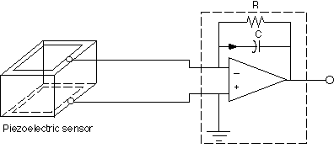
Yük Kuvvetlendiricisi
Electrode
v_{o}
The piezoelectric sensor generates charge, which is transferred to the capacitor, C, by the charge amplifier. Feedback resistor R causes the capacitor voltage to decay to zero

Slide 54
Yük Kuvvetlendiricisi: Devre
Sanal
Toprak
I_{sC} = I_{sR} = 0

Slide 55
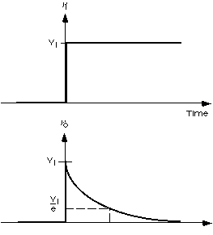
Yük Kuvvet. Basamak Cevabı
x_{i}
Deflection
The charge amplifier responds to a step input with an output that decays to zero with a time constant τ = R_{f}C_{f}
Time
v_{o}
v_{o max}
v_{o max} /e
Time

Slide 56
Yüksek Geçiren Süzgeç: Devre
Kazanç G nin denklemini çıkar
Önemli parametreler nelerdir?
G_{H} = -R_{f}/R_{i} ; τ_{i} = R_{i}C_{i} ; f_{c} = 1/2πτ_{i}

Slide 57
Yüksek Geçiren Süzgeç: Özellikleri
Gain/G_{H}
0.1
1
10
100
f/f_{c}
0.1
G/G_{H} yi f/f_{c} ye göre çiz
Eyim = +1
0.01
Phase
1
f/f_{c}
-π/2
-3π/4
Fazı f/f_{c} ye göre çiz
-π

Slide 58
Türev Alıcı - ideal
V₀ yu V_{i} cinsinden ifade et
Gain
100
10
0.1
1
10
100
f_{c} = 1/2πτ
1
f/f_{c}
0.1
Eyim = +1
0.01
Faz kayması = - 90º
Kazanç G nin ifadesini yaz

Slide 59
Türev Alıcı - Pratikte
In an ideal differentiator, the high
frequency response is limited by the
open-loop gain of the op-amp yielding
a very noisy output voltage.
C_{f} is used to limit the hf gain, hence the hf noise.
The gain at hf: G_{H} = - C_{i}/C_{f}
τ_{f} = R_{f}C_{f} ; f_{c} = 1/2πτ_{f}

Slide 60
Türev Alıcının Özellikleri
10
Gain/G_{H}
Without C_{f}
0.1
1
10
100
f/f_{c}
0.1
With C_{f}
High-pass filter
Differentiator
Slope = +1
0.01
Phase
1
f/f_{c}
-π/2
-3π/4
With C_{f}
-π

Slide 61
Band-pass filter: circuit
Mid-band gain =G_{MB} = - R_{f}/R_{i}
Time-constants: τ_{I}= R_{i}C_{i} ; τ_{f} = R_{f}C_{f}
Critical frequencies: f_{L} = 1/2πτ_{I} ; f_{H} = 1/2πτ_{f}

Slide 62
Band-pass filter: characteristics
Gain/G_{H}
0.1
1
10
100
f/f_{c}
0.1
Slope = +1
Slope = -1
0.01

Slide 63
C_{f}
Active filters
A low-pass filter attenuates high frequencies
A high-pass filter attenuates low frequencies and blocks dc.
A band-pass filter attenuates both low and high frequencies.
R_{i}
R_{f}
υ_{i}
−
υ_{o}
+
(a)
C_{i}
R_{i}
R_{f}
υ_{i}
−
υ_{o}
+
(b)
C_{f}
C_{i}
R_{i}
R_{f}
υ_{i}
−
υ_{o}
+
(c)
JH

Slide 64
Band-pass filter (non-inverting)

Slide 65
Frequency response of bpf

Slide 66
BPF with bias compensation

Slide 67
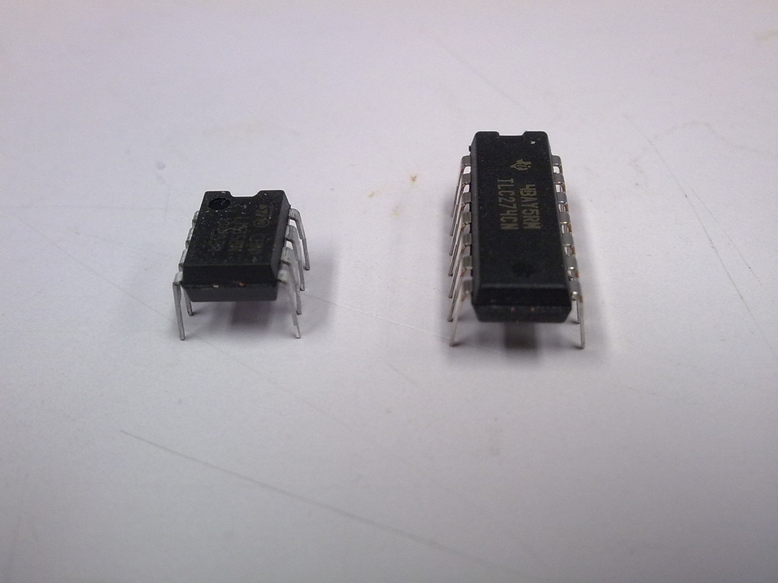
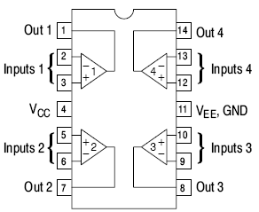
Op-Amps in Reality
Fabricated using integrated-
circuit technologies
  Inside an op-amp:
    Transistors
    Parasitic capacitors
    Internal resistors
Op-amp chip configuration that we will use: Quad-channel (i.e. 4-in-1)
  14 pins in the op-amp chip

Slide 68
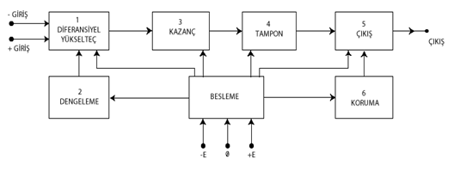
İşlemsel Kuvvetlendiricinin İç Yapısı

Slide 69
Internal diagram of an op-amp
+Vs
R2
1 k
200
Q1
Input
Q2
Input
R4
100
Null
Q4
V-
Io
V+
10 k
Q3
Q5
Output
10 k
10 k
3 k
3 k
-Vs
Differential input preamplifier
Level shifter
Output buffer
Output
Inputs

Slide 70
Frequency response: open-loop, uncompensated
Gain
[Gain-dB]
0
Slopes
100K
[100]
-1
10K
[80]
-2
1000
[60]
-3
[40]
100
[40]
10
[20]
Frequency (Hz)
1
[0]
10
100
10K
1M
100M
0.1
[-20]

Slide 71
Phase response
Phase
10
100
10K
1M
100M
0
Frequency (Hz)
-π/2
-π
-3π/2

Slide 72
Bode plot
Gain
100K
1000
Gain
margin
10
10
100
10K
1M
100M
0.1
Phase
Frequency (Hz)
0
-π/2
-π
-3π/2

Slide 73
Compensated and uncomp. op-amp
Gain
100K
Open-loop gain
10K
Uncompensated
Compensated
-1
1000
-1
Slopes
-2
100
-3
10
-2
Frequency (Hz)
1
10
100
10K
1M
100M
0.1

Slide 74
Internally compensated op-amp
Gain
100K
10K
Slope
= -1
1000
100
10
Unity gain BW
1
10
100
10K
1M
Frequency (Hz)
0.1
Slope
= -2

Slide 75
Frequency response: closed-loop
Gain
100K
Open-loop gain
10K
Compensated
Uncompensated
1K
Loop gain
100
Amplifier BW
10
Unity gain BW
Amplifier circuit gain
1
10
100
1K
10K
100K
1M
1
Frequency

Slide 76
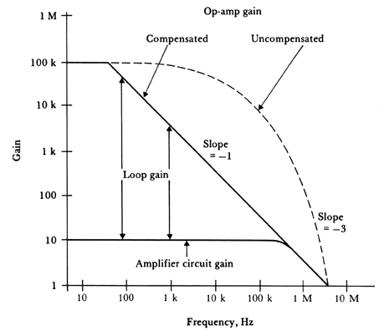
Op-amp Frekans Cevabı
Figure 3.13 Op-amp frequency characteristics early op amps (such as the 709) were uncompensated, had a gain greater than 1 when the phase shift was equal to –180º, and therefore oscillated unless compensation was added externally.
A popular op amp, the 411, is compensated internally, so for a gain greater than 1, the phase shift is limited to –90º. When feedback resistors are added to build an amplifier circuit, the loop gain on this log-log plot is the difference between the op-amp gain and the amplifier-circuit gain.

Slide 77
Slew rate = maximum output slope
I_{max}/C = dV₀/dt = Slew rate (S_{r}) (V/μs)
Compensation capacitor
Interim amplifier stage
For sinusoidal signals with V₀ = V_{or}*sin(ω_{p}t) where V_{or} is the maximum rated output voltage and ω_{p} =2πf_{p} is the maximum frequency of the signal; then the slew rate is S_{r} = 2πf_{p}V_{or} yielding
f_{p} =Sr /(2πV_{or}) = full-power response

Slide 78
Slew rate limitations
V_{i}
V₀
A
V_{i}
V₀=V_{or}sin2πft
V_{or}
Time
T
Slope = S_{r} = 2V_{or}/T₁
Time
V₀
-V_{or}
V_{or}
(dV₀/dt)_{max}
= 2πf*S_{r}
Maximum slope
Limited by
Slew rate = S_{r}
T₁
Time
-V_{or}

Slide 79
Output saturation current and feeding capacitive loads
I_{f}
R_{f}
I_{L}
V₀
V
1
R₀
I₀
+
R_{d}
R_{L}
C_{L}
A
(V
2
–
V
1
)
V
2
Don’t let equivalent resistance seen from the output below a few kΩ
Capacitive loads may impose slew-rate like limitations

Slide 80
Input and output voltage ranges
V_{S} = supply voltage
R2
1 k
200
+Vs
Q1
Input
Q2
Input
R4
100
Null
3 V < V_{S} < 18 V
V-
Q4
Q3
Io
V+
10 k
V_{S}
Q5
Output
10 k
3 k
10 k
3 k
-Vs
V_{CM}
V_{O}
V_{CM} = common mode input voltage
- V_{S} – 0.7V < V_{CM} < V_{S} + 0.7V
- V_{S} + 1 V < V_{O} < V_{S} – 1 V
-V_{S}

Slide 81
Bias currents & voltages
R_{1eq}
-
V₁
-
V_{b1}
I_{b1}
Ideal
Op-amp
+
V₀
V_{b2}
I_{b2}
R_{2eq}
V₂
+
I_{b1} and I_{b2} are input bias currents; input offset current I_{io} = I_{b1}- I_{b2}
V_{b1} and V_{b2} are input bias voltages; input offset voltage V_{io} = V_{b1}- V_{b2}

Slide 82
Problems with bias currents & voltages
Offset voltage
  Problem in amplifying low-level signals
  Can be nulled using a potentiometer
  Drift in time and with temperature
  Noise
Bias current
  Flows through feedback R; use small R (around 10 K, if R is too small then load current + f.b. current may exceed o/p current limit)
  Differential bias current (offset current)
  Drift
  Noise

Slide 83
Invert amp with bias compensation

Slide 84
Giriş Empedansı
−
R_{o}
υ_{o}
i_{i}
R_{d}
υ_{d}
+
Aυ_{d}
i_{o}
υ_{i}
−
+
R_{L}
C_{L}
Figure 3.15 The amplifier input impedance is much higher than the op-amp input impedance R_{d}. The amplifier output impedance is much smaller than the op-amp output impedance R_{o}.

Slide 85
Input and output impedances
I₀ = C_{L}dV₀/dt
Unity-gain follower
V₀ = AV_{d} = A(V_{i} – V₀) = AV_{i}/(A+1)
-V_{d} = V₀ = AV_{d} + I₀R₀
= -AV₀ + I₀R₀
Yielding (A+1)V₀ = I₀R₀
Hence, R₀ = V₀/I₀ = R₀/(A+1) ≅ R₀/A
I_{i} = V_{d}/R_{d} = V_{i}/(A+1)R_{d}
R_{i} = V_{i}/I_{i} = (A+1)R_{d} ≅ AR_{d}

Slide 86
Noise
Noise voltage (V.Hz^{-1/2}) or
Noise current (A.Hz^{-1/2}) in rms
1/f (flicker)noise
Colored noise
White noise
Popcorn noise
1/f noise
White noise
Frequency (Hz)
f_{L}
Bandwidth (BW)
f_{H}

Slide 87
Noise sources in an op-amp
R₁
V₁
+ -
I_{n}
V_{n}
-
AV_{d}
V_{d}
+ -
V₀
I_{n}
+
R₂
V₂
Characteristic noise resistance R_{n} = v_{n}/i_{n}

