Slide 1
KİMYASAL BİYOSENSÖRLER
Biyokimyasal
Analitlerin
Yoğunluğu
Elektriksel
İşaret
Biyosensörler
Kimyasal giriş
Kimya fabrikası
Kimyasal Çıkış
Active hücrelerden oluşan canlı gövde
Metabolit
gıda
Atık
ürün

Slide 2
Important Critical-Care Analytes
Blood gas and related parameters
  PO₂ , PCO₂ , pH
  SO₂ (oxygen saturation)
  Hematocrit, total hemoglobin (Hb)
Electrolytes, Na⁺ , K⁺ , Ca⁺⁺ , Cl⁻
Metabolytes
  Glucose, lactose
  creatine, urea

Slide 3
Clinical Laboratory Instrumentation
Responsible for analyzing patient specimens to provide information
  to aid in diagnosis of disease
  to evaluate effectiveness of therapy
Major sections:
  Chemistry lab
  Hematology
  Microbiology
  Blood bank
Notes:
Chemistry lab
performs analyses on blood, urine, cerebrospinal fluid (CSF) and other fluids to determine how much of various clinically important substances they contain
mainly measures concentration of analytes in a solution (mg/mm³)
Hematology
counts numbers and
determines characteristics of formed elements in blood
Microbiology
checks body tissues and fluids to see presence of pathological microorganisms
Tests susceptibility of microorganisms to antibodies, etc
Blood bank
A few systems are available for automation of the basic classification of the type of the blood products (ABO grouping)

Slide 4
Operations in a Clinical Laboratory
Sample handling
Performing tests
Discards used samples safely
Computer system for information management
  Analyzes and reports results
  Stores results in a data base
Notes:
Sample Handling
Naming and identification of tests needed
Mixing samples with reagents if necessary
Reagent is a material that interacts with the analyte concerned and optical properties of the reagent changes depending upon the concentration of the analyte
Incubation
sample allowed to reacts fully with reagent and
warmed up to certain temperature
Performing tests:
Mostly optical techniques are used to measure light absorbed or generated by the sample
Accuracy and precision of results are important
Quality control is essential

Slide 5
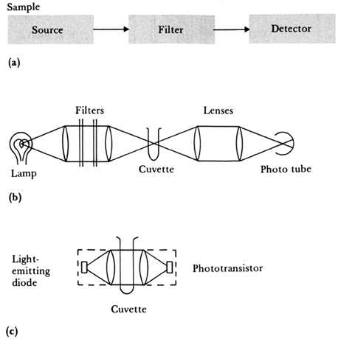
Basics Of Optical Instruments
General block diagram of an optical instrument
Highest efficiency is obtained by using an intense lamp, lenses to gather and focus the light on the sample in the cuvette, and a sensitive detector
Solid-state lamps and detectors may simplify the system
Notes:
Figure 2.17 (a) General block diagram of an optical instrument. (b) Highest efficiency is obtained by using an intense lamp, lenses to gather and focus the light on the sample in the cuvette, and a sensitive detector. (c) Solid-state lamps and detectors may simplify the system.
Basics Of Optical Instruments
(a) shows general block diagram of an optical instrument. A light source illuminates the sample in a cuvette and detector receives the light that passed through the cuvette and generates an electrical output related to it.
Set-up shown in (b) provides highest efficiency by using an intense lamp, gathering the light through lenses and focusing on the cuvette and a sensitive detector.
Solid-state sources and detectors shown in (c) may simplify the system. Led and phototransistor have lenses built-in

Slide 6
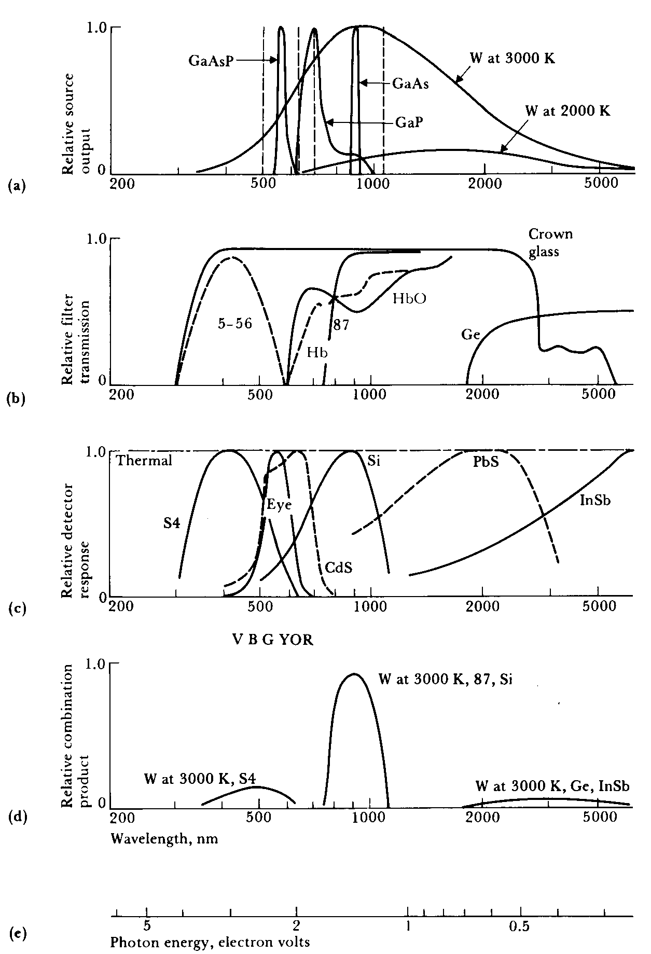
Light Sources
(green)
Tungsten
(red)
Lasers (monochromatic):
  Argon 515 nm
  He-Ne 633 nm
  Ruby 693
  Nd:YAG 1064 nm
  CO₂: 10,600 nm (not shown)
Tungsten lamps
Arc discharges
Light emitting diodes (leds)

Slide 7
Filters
Kodak
Corning
Glass and wratten filters
Germanium lenses for long λ
Two polaroid filters
Interference filters
Diffraction grating

Slide 8
Radiation Sensors (Photo-detectors)
Thermal sensors
Quantum sensors
Photo-emissive sensors
Photo-conductive cells
Photo-junction sensors
Photo-voltaic cells
Notes:
Thermal sensors - absorb radiation and transforms it to heat
Thermistors and thermocouples
Pyroelectric sensor - rise in T changes polarization of the crystal and generates current proportional to T
Quantum sensors - absorb energy of photon and release electron in a restricted wavelength
human eye, photo-diode, photo-tube, photographic emulsion
Photo-emissive sensors - photo-cathode receives photon and emits electron
Photo-tube, photo-multiplier
Photo-conductive cells - conductivity changes with light
crystalline materials suh as CdS or PbS deposited on a seramic substrate with ohmic electrodes attached
Linear at low light intensities, slow response
Photo-junction sensors - pn junction usually made up of silicon
Fast response
Photo-voltaic sensors - solar cells

Slide 9
Spectral response including source, filter and detector
Photon energy: less than 1 eV may not cause current flow in Si p-n junctions

Slide 10
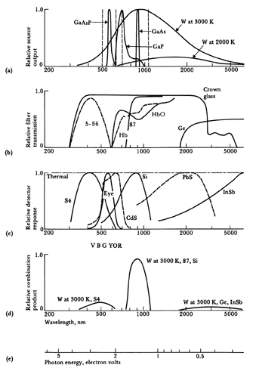
Spectral characteristics of sources, filters, detectors, and combinations thereof
Notes:
Figure 2.18 Spectral characteristics of sources, filters, detectors, and combinations thereof (a) Light sources, Tungsten (W) at 3000 K has a broad spectral output. At 2000 K, output is lower at all wavelengths and peak output shifts to longer wavelengths. Light-emitting diodes yield a narrow spectral output with GaAs in the infrared, GaP in the red, and GaAsP in the green. Monochromatic outputs from common lasers are shown by dashed lines: Ar, 515 nm; HeNe, 633 nm; ruby, 693 nm; Nd, 1064 nm; CO₂ (notshown), 10600 nm. (b) Filters. A Corning 5-65 glass filter passes a blue wavelength band. A Kodak 87 gelatin filter passes infrared and blocks visible wavelengths. Germanium lenses pass long wavelengths that cannot be passed by glass. Hemoglobin Hb and oxyhemoglobin HbO pass equally at 805 nm and have maximal difference at 660 nm. (c) Detectors. The S4 response is a typical phototube response. The eye has a relatively narrow response, with colors indicated by VBGYOR. CdS plus a filter has a response that closely matches that of the eye. Si p-n junctions are widely used. PbS is a sensitive infrared detector. InSb is useful in far infrared. Note: These are only relative responses. Peak responses of different detectors differ by 107. (d) Combination. Indicated curves from (a), (b), and (c) are multiplied at each wavelength to yield (d), which shows how well source, filter, and detector are matched. (e) Photon energy: If it is less than 1 eV, it is too weak to cause current flow in Si p-n junctions.

Slide 11
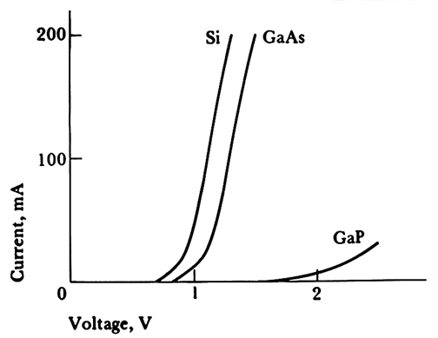
Forward characteristics for p-n junctions
Notes:
Figure 2.19 Forward characteristics for p-n junctions. Ordinary silicon diodes have a
band gap of 1.1 eV and are inefficient radiators in the near-infrared. GaAs has a band gap of 1.44 eV and radiates at 900 nm. GaP has a band gap of 2.26 eV and radiates at 700 nm.

Slide 12
Fiber optics
Coating
Air
n = 1.0
θ₂
n₂
θ_{ic}
Fiber
θ₁
θ₄
θ₃
n₁
The solid line shows refraction of rays that escape through the wall of the fiber. The dashed line shows total internal reflection within a fiber.
Snell’s law: n₁sinθ₁ = n₂sinθ₂ , where n₁ and n₂ refractive index
of medium 1 and 2, θ₁ and θ₂ are the angles with the normal in
medium 1 and 2 respectively.
Notes:
Figure 2.20 Fiber optics. The solid line shows refraction of rays that escape through the wall of the fiber. The dashed line shows total internal reflection within a fiber.

Slide 13
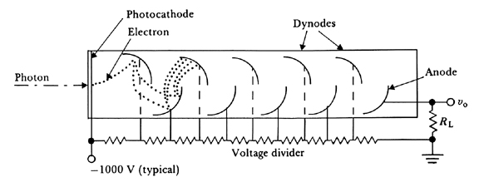
Photomultiplier
An incoming photon strikes the photocathode and liberates an electron. This electron is accelerated toward the first dynode, which is 100 V more positive than the cathode. The impact liberates several electrons by secondary emission. They are accelerated toward the second dynode, which is 100 V more positive than the first dynode, This electron multiplication continues until it reaches the anode, where currents of about 1 mA flow through RL.
Notes:
Figure 2.21 Photomultiplier An incoming photon strikes the photocathode and liberates an electron. This electron is accelerated toward the first dynode, which is 100 V more positive than the cathode. The impact liberates several electrons by secondary emission. They are accelerated toward the second dynode, which is 100 V more positive than the first dynode, This electron multiplication continues until it reaches the anode, where currents of about 1 μA flow through R_{L}.

Slide 14
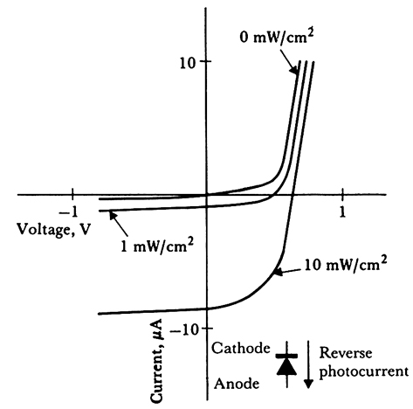
Voltage-current characteristics of irradiated silicon p-n junction
Photo-junction sensors:
Photodiode, phototransistor,
photo darlington transistor,
photo-unijuntion transistor,
photon (opto) couplers
For 0 irradiance, both forward and reverse characteristics are normal. For 1 mW/cm2, open-circuit voltage is 600 mV and short-circuit current is 8 mA
Notes:
Figure 2.22 Voltage-current characteristics of irradiated silicon p-n junction. For 0 irradiance, both forward and reverse characteristics are normal. For 1 mW/cm², open-circuit voltage is 600 μV and short-circuit current is 8 μA.

Slide 15
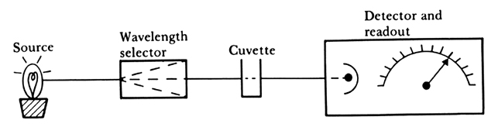
Spectrophotometry
The most common technique used in may clinical lab instruments
Photometer, no filter
Colorimeter, glass filter that selects a range of wavelengths
Spectrophotometer:
  Wavelength selection with a narrow-band filter - monochromator
  Wavelength can be adjusted and provides a quantitative reading.
Notes:
Figure 11.1 Block diagram of a spectrophotometer (Based on R. J. Henry, D. C. Cannon, and J. W. Winkelman, eds., Clinical Chemistry, 2nd ed. Hagerstown, MD: Harper & Row, 1974.)

Slide 16
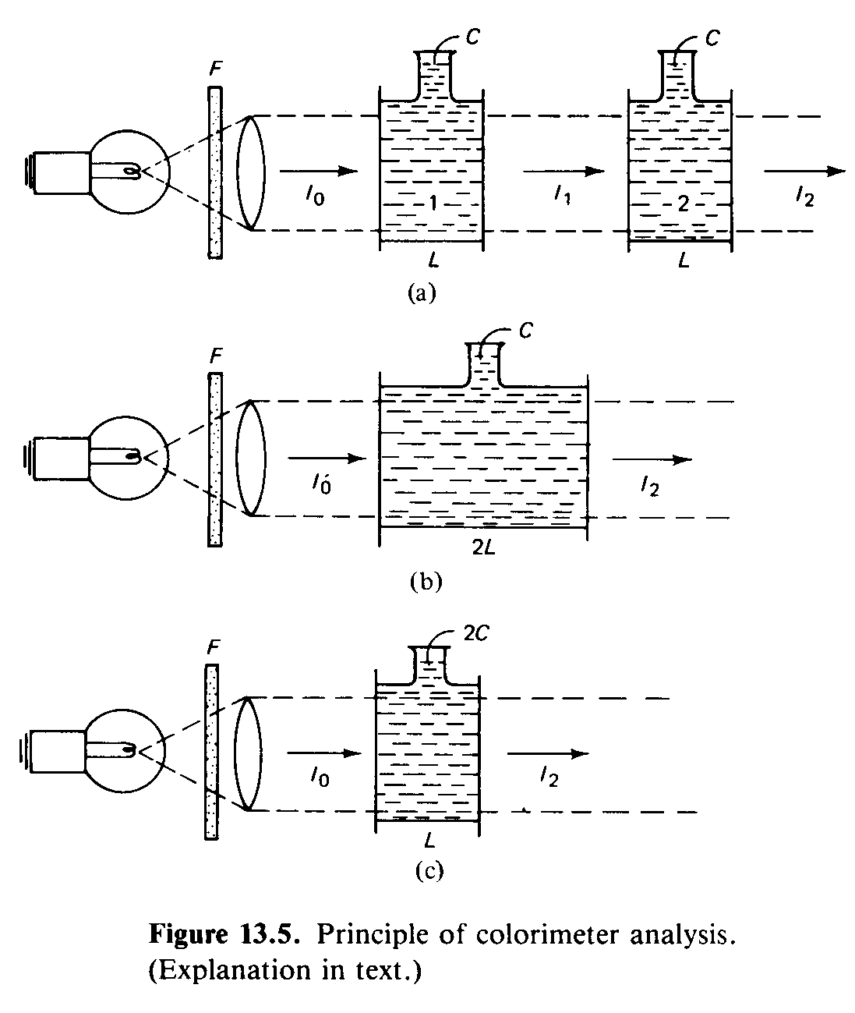
Principles
Beer's law:
Pt = Po10^{-aLC}
T = Pt*100/Po =10^{-aLC}
Absorbance:
A = aLC
Notes:
Principle of colorimeter analysis
Beer's law: Pt = Po10^{-aLC} where
Po : radiant energy arriving at the cuvette
Pt : Radiant energy leaving the cuvette
a: absorptivity of the sample (extinction coefficient)
L : Length of the path through the sample
C : Concentration of the absorbing sample
% transmittance (T) = Pt*100/Po =10^{-aLC}
Absorbance A= log (Po/Pt) = log(100/%T) = 2 - log(%T) = 2 - (2 - aLC);
∴ A = aLC

Slide 17
Utilization of Reagent
Unknown
chemical
concentration
Reagent
Light source
Color
density
Light
intensity
Electrical
meter
Photodetector
Reading of
unknown
concentration
Electrical
signal
Most substances do not have energy absorption characteristics. Special chemicals are used.
Reagent (special chemicals) must have:
  Complete reaction with the unknown
  Reaction product should have strong color
  Unknown should not have color itself
Notes:
Most substances of clinical interest have high concentrations of analytes. Dilutent: Chemical substance that reduces the concentration of the sample in the solution without effecting it's composition.
In vast majority of cases, these substances, as they are found in patient’s samples (of serum, urine, CSF, etc) do not show the desired energy absorption characteristics.
Special chemicals, called reagents are added to the sample causing a chemical reaction to occur. This reaction yields a product that has the required optical characteristics, and it is placed in the cuvette for the analysis.

Slide 18
Some Observations on Light
Photon is a light particle with zero resting mass
Color perception is measured by special cells (rhodes and cones in the retina)
  At low light, human eye perceives objects in black and white only.
Colors are classified as:
  Pure colors - a very narrow energy band
  Non pure colors - wide bandwidth that contains many frequencies
White light contains infinite number of wavelengths
The electromagnetic spectrum identified as:
  Visible (human eye can see colors) from 400 to 700 nm
  Ultraviolet from 200 to 400 nm
  Infrared from 700 to 900 nm

Slide 19
Power Sources
Hydrogen and deuterium discharge lamps
  Continuous spectrum with most power in IR range
  Operating above the nominal voltage increases the power in visible and UV ranges and can be used from 200 to 360 nm
Tungsten filament
  Operation from 360 to 800 nm
  Problems due to aging and voltage dependence; lamp output varies as the fourth power of filament voltage
  Controlling the supplying input, self calibration is possible
Power sources used:
  Batteries, mainly Ni-Cd rechargeable, limited use
  Constant voltage transformers, no active element, reliable, but frequency dependent
  Electronic power supplies with solid-state components

Slide 20
Wavelength Selectors
Filters
  Glass filters - BW 50 nm
  Interference filters - BM 10 to 15 nm
Monochromators
  Prism - BW 0.5 nm
    Glass
    Quartz, for < 350 nm
  Diffraction grading - BW down to 0.5 nm

Slide 21
Filters
Glass filters
  Glass is treated with some materials to absorb some wavelength and transmit some others
  Multilayer of glass filters are used to obtain highpass, lowpass and bandpass characteristics
  Bandwidth around 50 nm, hence can't distinguish between particle whose optical spectrums are close to each other
Interference filters
  Two layers of half silver glass separated by a transparent dielectric spacer of distance λ /2
    Transmittance between 40 to 60 %
    Bandwidth 10 to 15 nm
  Made up of successive layers of dielectric with high and low indices
    Transmittance up to 90%
    BW down to 4 nm
    Mostly operate in UV range
  Costly
  Generates harmonics of the nominal wavelength

Slide 22
Monochromators
Prisms
  Glass
  Quartz for < 350 nm
  Spectrum of light produced
  Nonlinear spatial distribution
Diffraction grating
  More linear spatial distribution
Stray light due to impurities in grating
  Harmonics
Bandwidth down to 0.5 nm

Slide 23
Calculation of Concentration
Absorbance in standard (As) (dilutent + reagent + known amount of the measured sample) is determined.
Absorbance of the sample (unknown) (Au) is measured.
Using the Beer's law:
Cu = Cs (Au/As)
  where Cu and Cs are concentrations of unknown and standard in the sample respectively

Slide 24
Photometer
Photodetector
Quantum sensors - absorb energy of photon and release electron in a restricted wavelength
    human eye, photodiode, phototube, photographic emulsion
  Photoemissive sensors - photocathode receives photon and emits electron
    Phototube, photomultiplier
  Photoconductive cells
  Photojunction sensors
  Photovoltaic sensors - solar cells
Signal processing and display
  Amplifiers
  Linearizers
  Signal processing devices, integrators, differentiators, filters
  Analog and digital display
  Recording devices

Slide 25
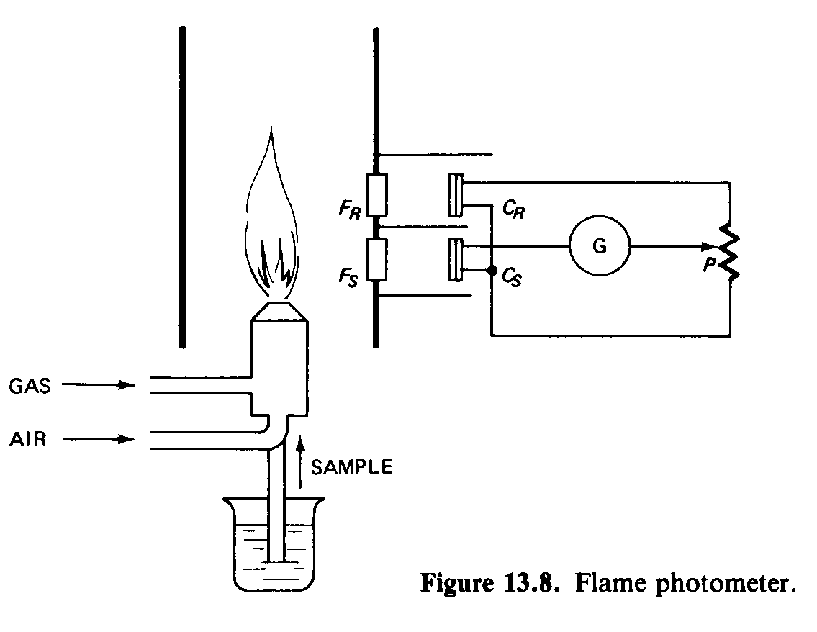
Flame Photometers
Notes:
Flame photometer is an optical electronic device that measures the color intensity of a substance (like sodium or potassium) aspirated into a flame.
Differs from spectrophotometers in three ways:
Power source and sample holder functions are combined in the flame
Objective is measurement of sample's emission rather than absorption of light
Can determine only concentrations of pure metals

Slide 26
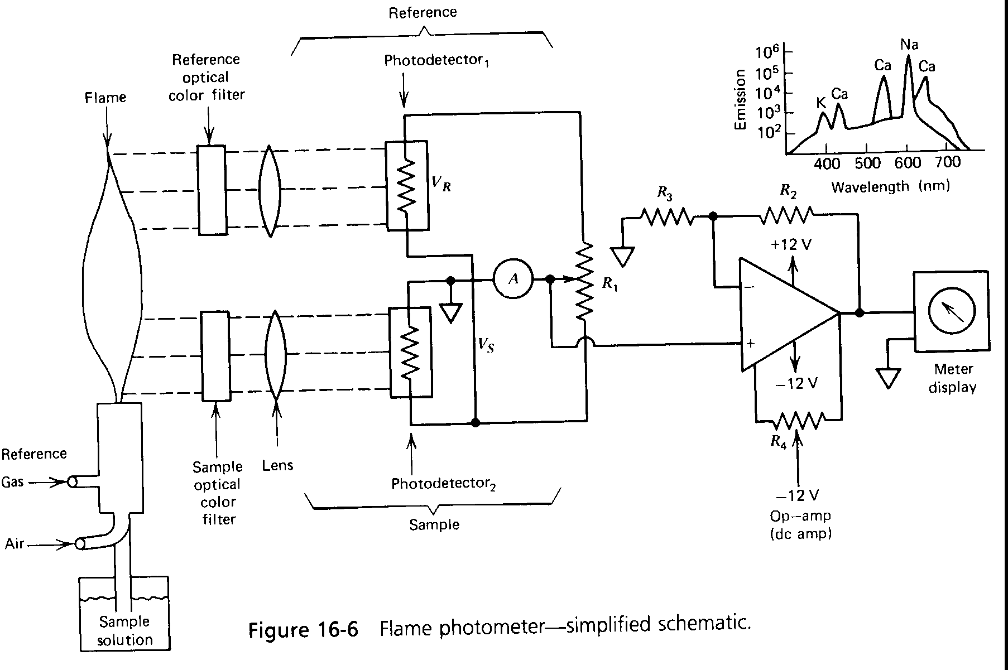

Slide 27
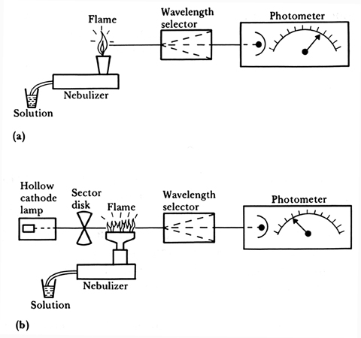
Types of Flame Photometers
Atomic emission
Atomic absorption
Notes:
Figure 11.2 Block diagram of instruments for (a) flame emission and (b) flame
absorption. (Based on R. J. Henry, D. C. Cannon, and J. W. Winkelman, eds., Clinical Chemistry, 2nd ed. Hagerstown, MD: Harper & Row, 1974.)

Slide 28
Flame Photometers
Differs from spectrophotometers in three ways:
  Power source and sample holder functions are combined in the flame
  Objective is measurement of sample's emission rather than absorption of light
  Can determine only concentrations of pure metals
Atomic emission
  Only about 1 % goes from ground state to excited state
  Used for Na⁺, K⁺ and Li⁺
  Li⁺ does not exist in the body normally and it is used as a reference
Atomic absorption
  A chopped light is used at specific wavelength of the substance to be analyzed
  Energy is absorbed as the atom goes from ground state to excited state
  Used for calcium, lead, copper, zinc, iron and magnesium

Slide 29
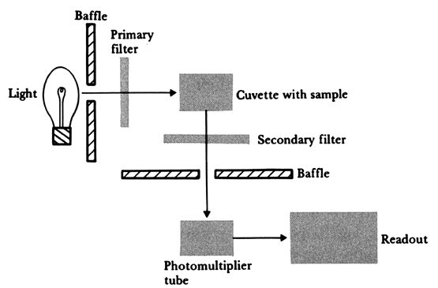
Block diagram of a fluorometer
Notes:
Figure 11.3 Block diagram of a fluorometer (Based on R. Hicks, J. R. Schenken, and M. A. Steinrauf, Laboratory Instrumentation. Hagerstown, MD: Harper & Row, 1974. Used with permission of C. A. McWhorter.)
A number of molecules emit light in a characteristic spectrum (the emission spectrum) immediately after absorbing radiant energy and being raised to an excited state.

Slide 30
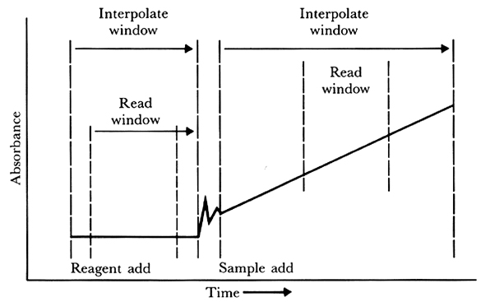
Figure 11.4 Synchron CX4 measurement read window for a rate-type measurement

Slide 31
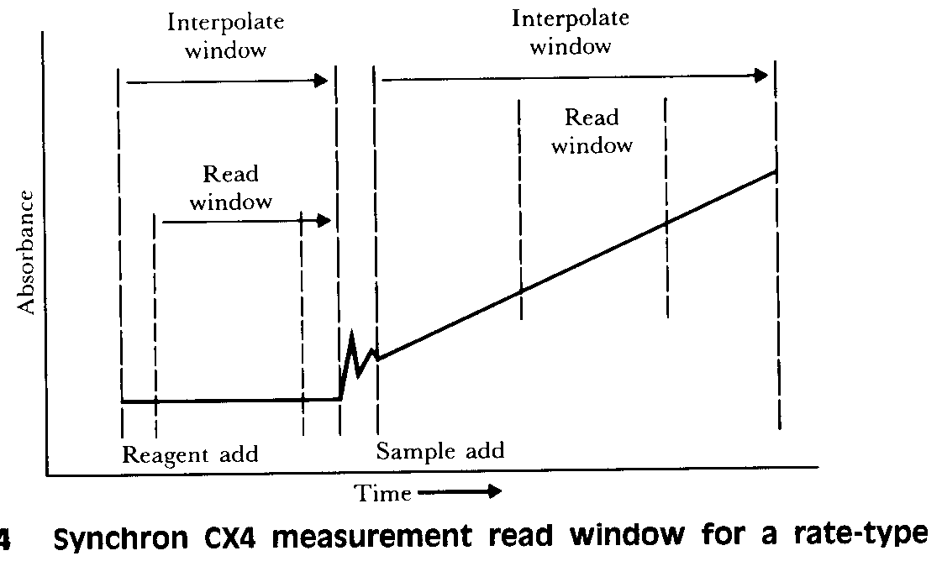
CX4 measurement read window
Synchron CX4 measurement read window for a rate-type measurement.
Notes:
The Synchron CX4 includes three major subsystems as specimen handling, reagent handling and cuvette reaction systems.
Testing cycle consists of the service interval and the analytical spin cycle. Each of the 80 cuvettes sequentially goes through these steps within the testing cycle. During the service interval (10 s) the test reaction is initiated. In this interval, products of previous tests are removed from the cuvette, test reagents and test samples are placed. During the analytical spin cycle, the sample carousel is spun at 90 rpm for 6 s. The cuvette passes through the optic station for reading the absorbance. The reading can be done at ten distinct frequencies and five of them are used for each sample. During each spin cycle, each cuvette passes through the optic station eight times. The number of spin cycles varies with the type of test. For glucose determination for example 13 spin cycles are used and it takes about 200 s for the completion of the test (each cycle takes 16 s).
In an endpoint reaction, the absorbance at the time of last measurement is used. In the rate type measurement each single measurement is used to determine the rate of change of the absorbance of the reaction mixture.

Slide 32
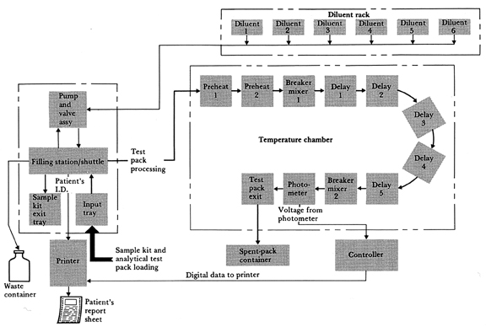
Block Diagram of ACA
Notes:
Figure 11.5 Block Diagram of ACA (From ACA Instrument Instruction Manual,
Dupont Company, Automatic Clinical Analysis Division, Wilmington, DE 19898.)

Slide 33
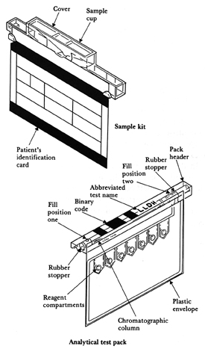
Sample kit and analytical test pack of ACA
Notes:
Figure 11.6 Sample kit and analytical test pack of ACA (From ACA Instrument Instruction Manual, Dupont Company, Automatic Clinical Analysis Division, Wilmington, DE 19898.)

Slide 34
Chromatology
Separation of mixture of substances into component parts
Patient sample (with a volatile solvent) flash evaporates as it enters
It is carried out through the column (1 m long ang about 7 mm in diameter)
Each element is delayed seperately in the column and appears at the output yielding different elements at different times

Slide 35
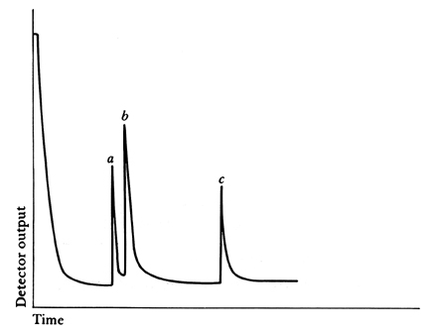
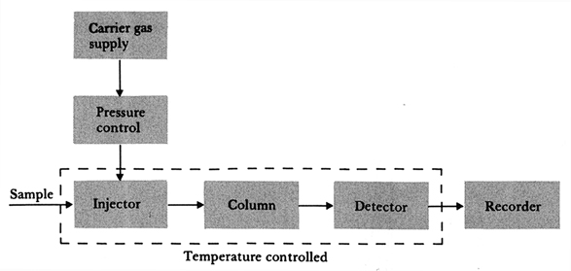
A gas-liquid chromatograph (GLC)
Example of GLC recording
for analysis of blood levels
(a) phenobabital
Heptabarbital
(internal standard)
phenytoin
Notes:
Figure 11.7 Block diagram of a gas-liquid chromatograph (GLC)
Figure 11.8 Example of a GLC recording for the analysis of blood levels of phenobarbital (peak a) and phenytoin (peak c). Peak b corresponds to the level of heptabarbital (the internal standard).
(inset)
Separation of mixture of substances into component parts.
The name is misleading since it does not separate substances on the principle of color.
Patient sample (with a volatile solvent) flash evaporates as it enters
It is carried out through the column (1 m long and about 7 mm in diameter)
Each element is delayed separately in the column and appears at the output yielding different elements at different times.
Figure at the inset shows an example recording obtained from analysis of a blood specimen for levels of important drugs.
Advantages in analyzing complex compounds. Work with small amounts of samples, and great sensitivity. Analysis is completed in less than 1 hour, usually in less than 15 s.

Slide 36
Electrophoresis
Functions:
  Measures quantities of various types of proteins in plasma, urine and CSF
Seperates enzymes into their component isoenzymes
  Identifies antibodies, etc
Operation
  Sample is applied to medium
  Under electric field, groups of particles similar in charge, size and shape migrate at similar rates yielding
Seperation of particles into zones over the bridge

Slide 37
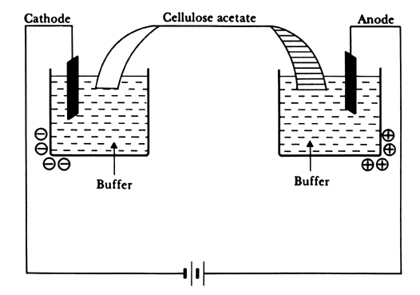
Cellulose acetate electrophoresis
Notes:
Figure 11.9 Cellulose acetate electrophoresis (Based on R. Hicks, J. R. Schenken, and M. A. Steinrauf, Laboratory Instrumentation. Hagerstown, MD: Harper & Row, 1974. Used with permission of C. A. McWhorter.)
Functions: Measures quantities of various types of proteins in plasma, urine and CSF; separates enzymes into their component isoenzymes; identifies antibodies, etc
Operation: Sample is applied to medium.Under electric field, groups of particles similar in charge, size and shape migrate at similar rates yielding separation of particles into zones over the bridge.
A typical voltage of 250 V, current 4-6 mA initially, slightly increases during measurement.15-20 min for the measurement. Fix migrated protein bands to the buffer and stain them. Membrane is cleared without affecting the densities due to dyed-specimen fractions. It is dried and densities are measured by a densitometer. Densitometer is similar to colorimeter and measures optical transmittance (density) of particles. It consists of a light source, filter and detector (typically photo-diode).

Slide 38
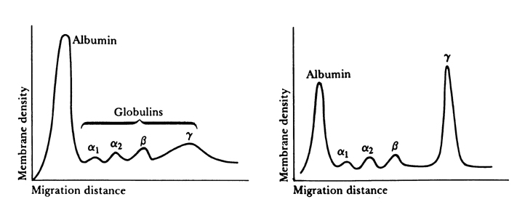
Examples of patterns of serum protein electrophoresis
Notes:
Figure 11.10 Examples of patterns of serum protein electrophoresis The left-hand pattern is normal; the right-hand pattern is seen when there is an over production of a single type of gamma globulin.
The membrane is placed on a holder in the densitometer, the path of migration of one of the specimens is scanned. The output voltage is amplified by a very stable preamplifier. The output is plotted using an x-y recorder. It is also integrated to determine the area under the peaks.

Slide 39
Hematology
Blood:
  Formed elements
    Red blood cells (RBC) - erythrocytes; 4.6 to 6.2*10⁶/µl in men and 4.2 to 5.4*10⁶/µl in women
    White blood cells (WBC) - leucocytes; 4500 to 11000/µl
    Platelets - thrombocytes, 4 to 4 µm in size and 150,000 to 400,000/µl
Substances in solution
Water
Packed RBC volume = hematocrit (HCT)
  Expressed in the ratio of formed elements to total volume
  40 to 54 % in adult men
  35 to 47 % in adult women
Hemoglobin (Hb) in grams/dl
  13.5 to 18 g/dl in adult men
  12 to 16 g/dl in adult women

Slide 40
Blood cells
Mean corpuscular volume
MCV: 82 to 98 µm³
Mean corpuscular hemoglobin
MCH : 27 to 31 pico gram
Mean corpuscular hemoglobin content MCHC: 32 to 36 %
MCV = 10 HCT / RBC count
MCH = 10 Hg / RBC count
MCHC = 100 Hg / HCT

Slide 41
A block diagram of a Coulter Model STKS
Diluter I
Diluting
fluid
WBC
stabilizing
agent
Lysing
agent
Diluter II
Lysing
and
mixing
Lysing
and
mixing
Triple
transducer
module
WBC
bath
Hemoglobin-
ometer
Hgb
RBC
bath
C
C
C
C
C
C
Analyzer computer
Laboratory
computer
system
Data
management
system
Printer
Notes:
Figure 11.11 A block diagram of a Coulter Model STKS. (Modified from J. Davidsohn and J. B. Henry, Todd Sanford Clinical Diagnosis by Laboratory Methods, 15 ed. Philadelphia: W. B. Saunders Co.)

Slide 42
Coulter STKS aperture bath
Vacuum (6"Hg)
Aperture
current
Internal
electrode
100 μm
+
External
electrode
75 μm
-
Blood
cell
suspension
Sample
beaker
Detail of
aperture
(WBC)
Aperture
Aperture tube
Notes:
Figure 11.12 Coulter STKS aperture bath

Slide 43



Two-dimensional scatterplot
Neutrophils
Eosinophils
Monocytes
WBC volume
Lymphocytes
Light scatter
Notes:
Figure 11.13 Two-dimensional scatterplot.

Slide 44

Block diagram of HEMATRAK
Video
scanner
Color
analyzer
Image memory
Stage and focus
motor drives
Reference
memory
Keyboard
Cytoplasm morphology
Neutrophils
Nucleus morphology
Bands
Eosinophils
Normal
cell
counters
Granularity
Basophils
Morphological
analyzer
Nuclear/cytoplasm
ratio
Recognition
computer
Monocytes
Lymphocytes
Chromatin pattern
Atypical lymphocytes
Color
Blast-like cells
"Suspect“
cell
counters
Nucleated erythrocytes
Vacuolization
Other immature cells
Video
display
Ticket printer
Notes:
Figure 11.14 Block diagram of HEMATRAK (From M. Levine, "Automated differentials: Geometric Data's HEMATRAK," Amer, J. Med. Tech., 40: 464, 1974.)

